Slide 1
Disruption Mitigation in ITER
M. Lehnen
ITER Organization, Route de Vinon sur Verdon, CS 90 046, 13067 Saint Paul-lez-Durance, Cedex, France
Disclaimer:
ITER is the Nuclear Facility INB no. 174. This presentation explores physics processes during the plasma operation of the tokamak when disruptions take place; nevertheless the nuclear operator is not constrained by the results presented here. The views and opinions expressed herein do not necessarily reflect those of the ITER Organization.

Slide 2
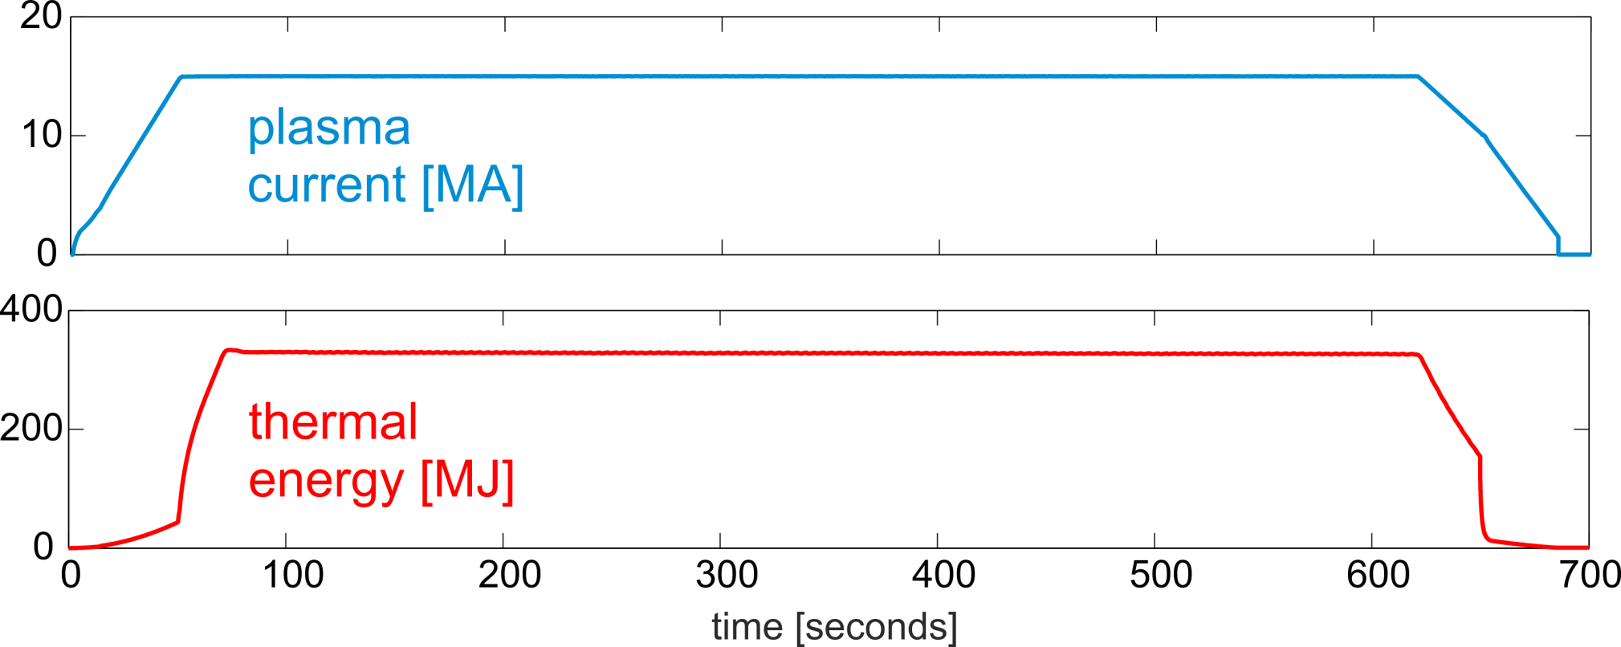
Plasma Disruption
ITER target plasma scenario

Slide 3
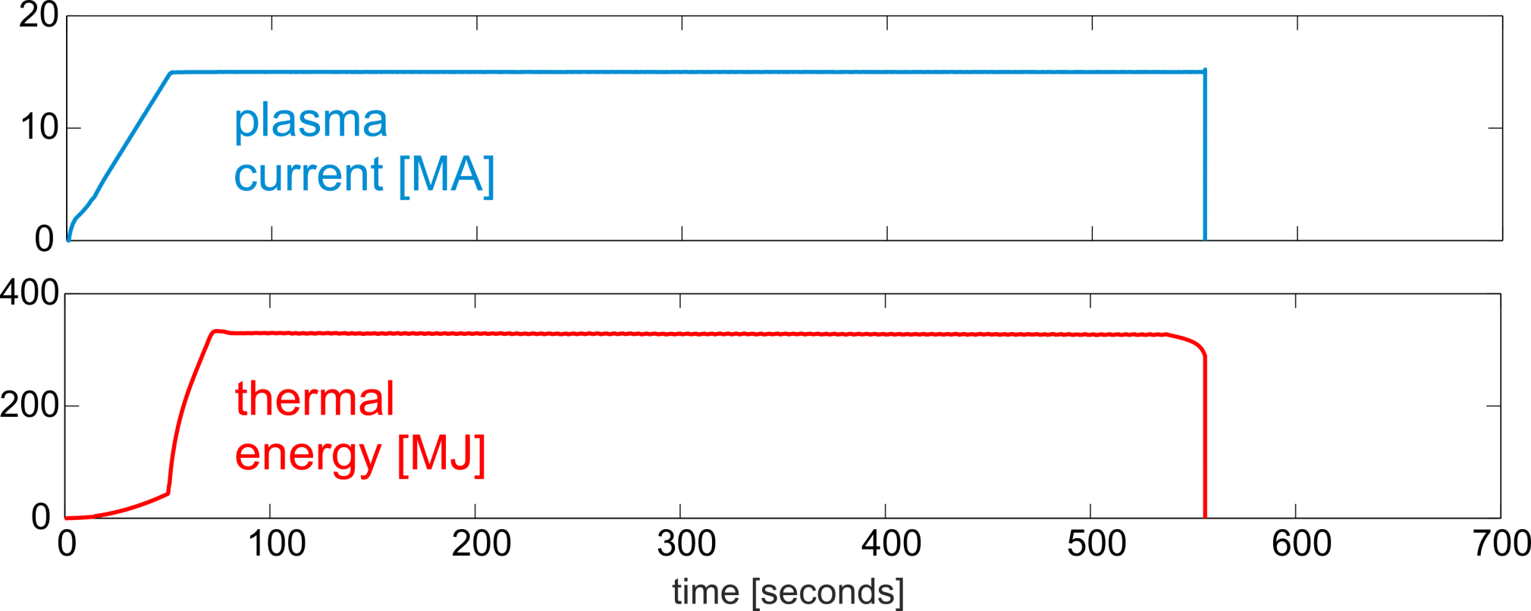
Plasma Disruption
Plasma Disruption

Slide 4
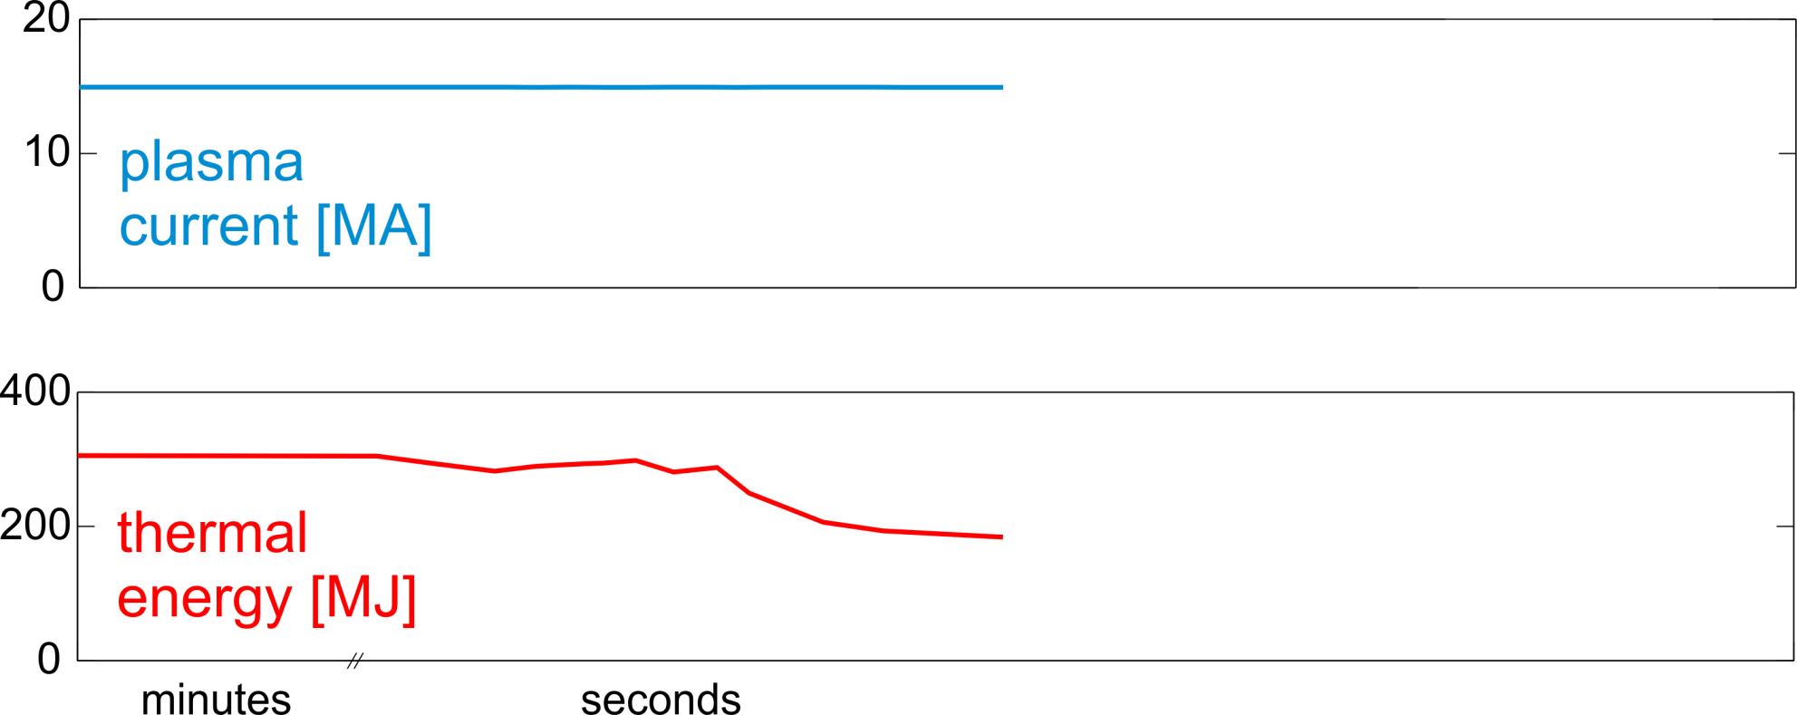
Plasma Disruption
Plant system failure / Plasma instabilities

Slide 5
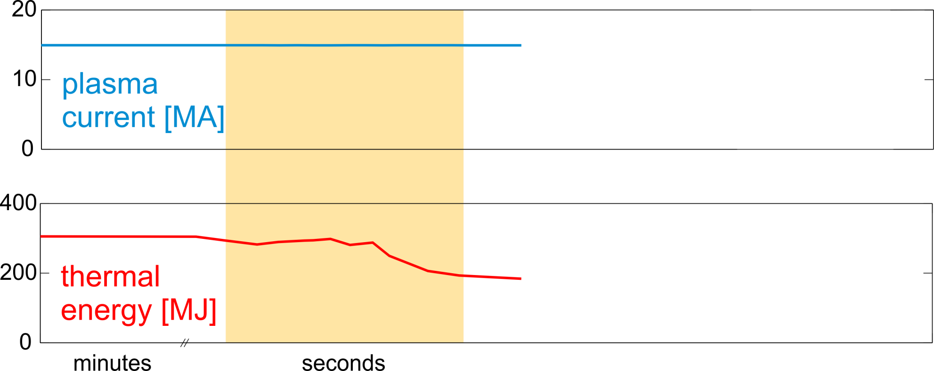
Plasma Disruption
Plasma Control System
Exception handling
(recover or controlled/emergency shutdown)

Slide 6
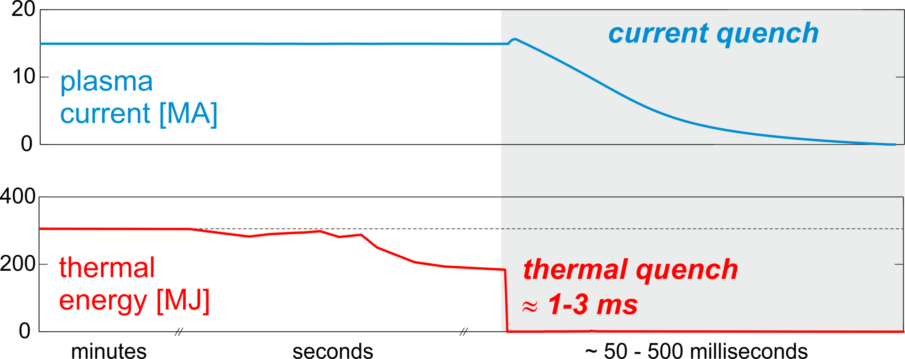
Plasma Disruption

Slide 7
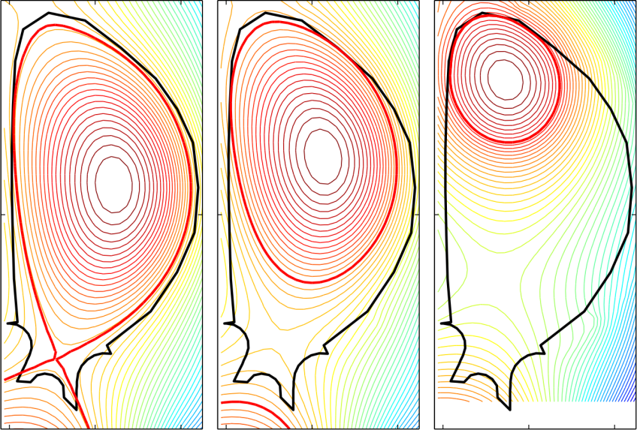
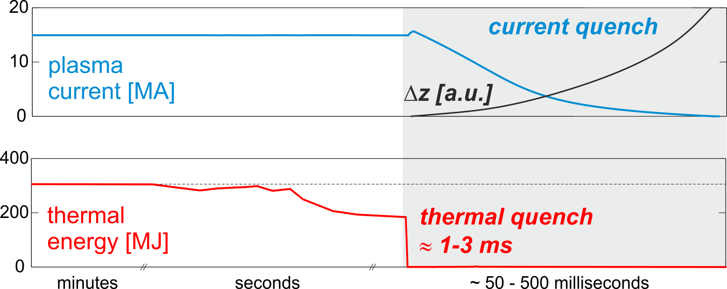
Plasma Disruption

Slide 8
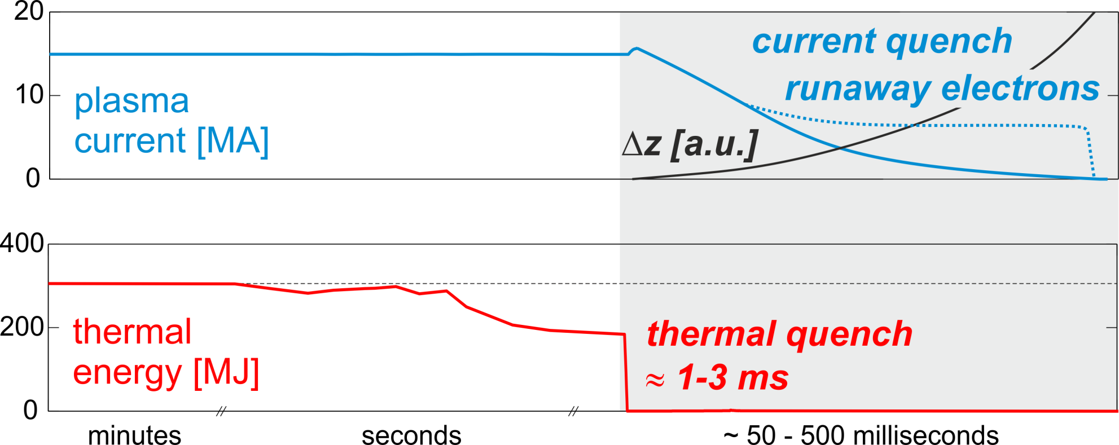
Plasma Disruption

Slide 9
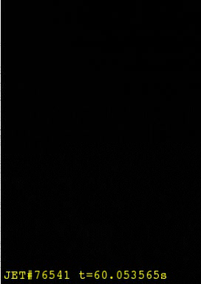
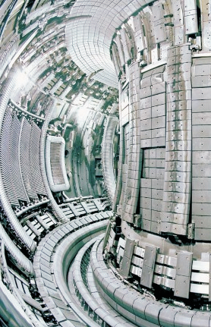
Plasma Disruption
JET
movie: 40 ms

Slide 10
Outline – Four main challenges
Disruption Loads
Control Disruption rate and
achieve high mitigation success rates*
Achieving the mitigation aims
(especially runaway electron mitigation)
Mitigation Technology
*Disruption Avoidance techniques and techniques to trigger the mitigation system are not covered in this presentation.

Slide 11
Disruption Loads

Slide 12
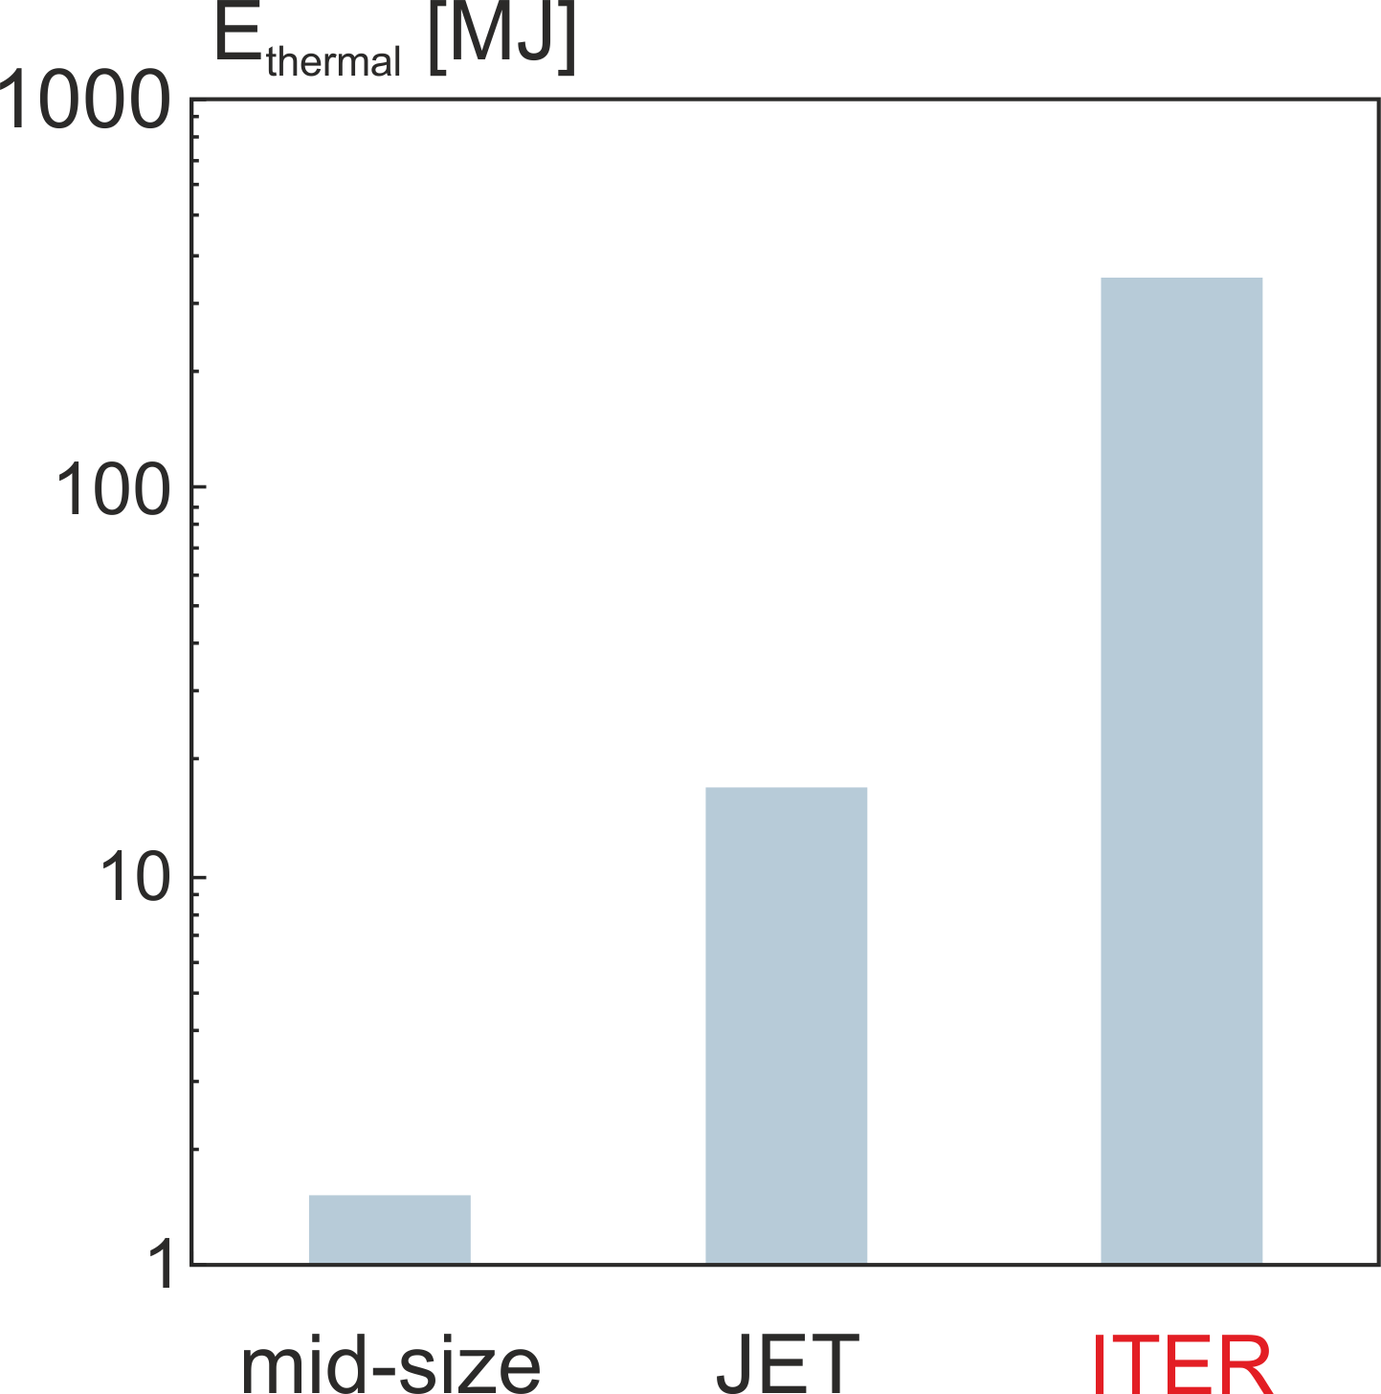
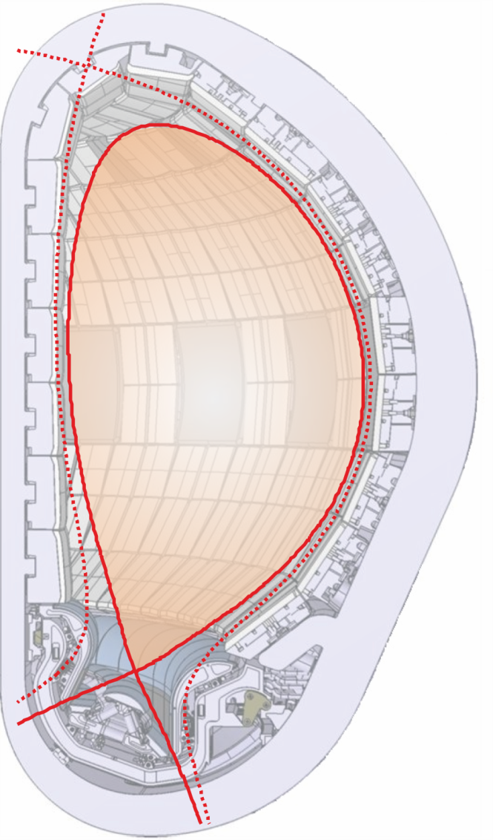

Why is mitigation required in ITER?
Thermal Energy
up to
350 MJ
$$E_{thermal}\sim R^{5}$$

Slide 13
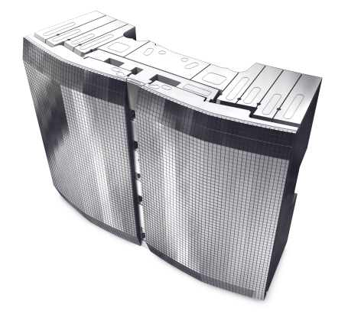
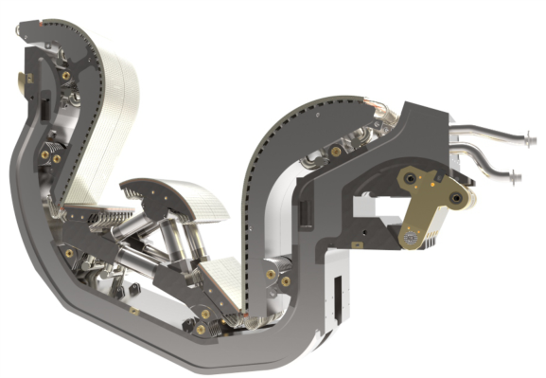
Why is mitigation required in ITER?
Thermal Energy
Beryllium
up to
350 MJ
$$E_{thermal}\sim R^{5}$$
Tungsten

Slide 14
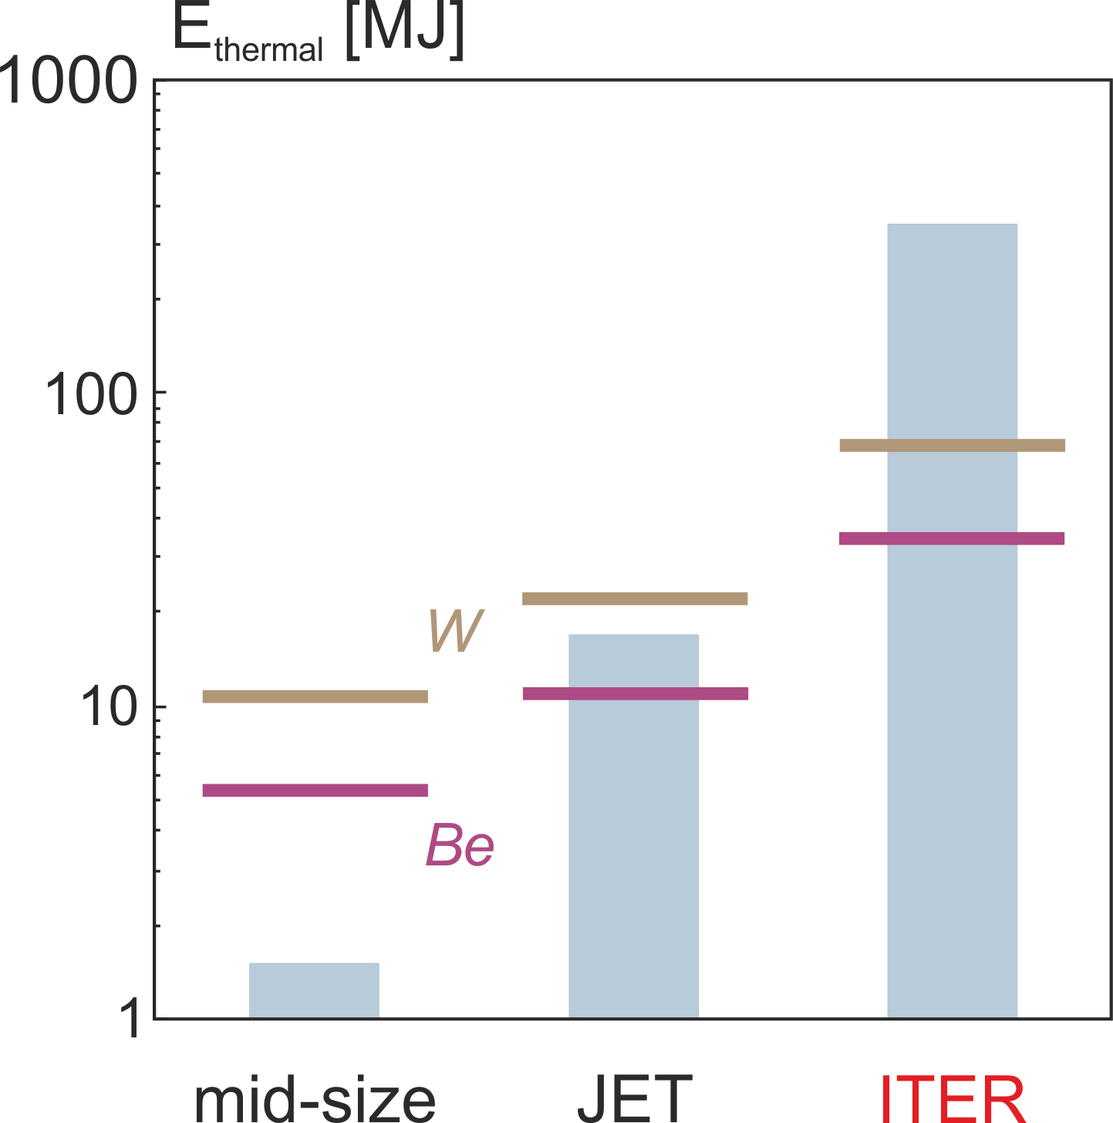

Why is mitigation required in ITER?
Thermal Energy
Beryllium
up to
350 MJ
$$E_{melt}\sim R^{3/2}$$
$$E_{thermal}\sim R^{5}$$
Tungsten
Melt limit: $t_{TQ}\sim R$; $A\sim Rλ;ΔT \sim E_{thermal}/A\sqrt{t_{TQ}}$ → $E_{melt}\sim R^{3/2}$

Slide 15
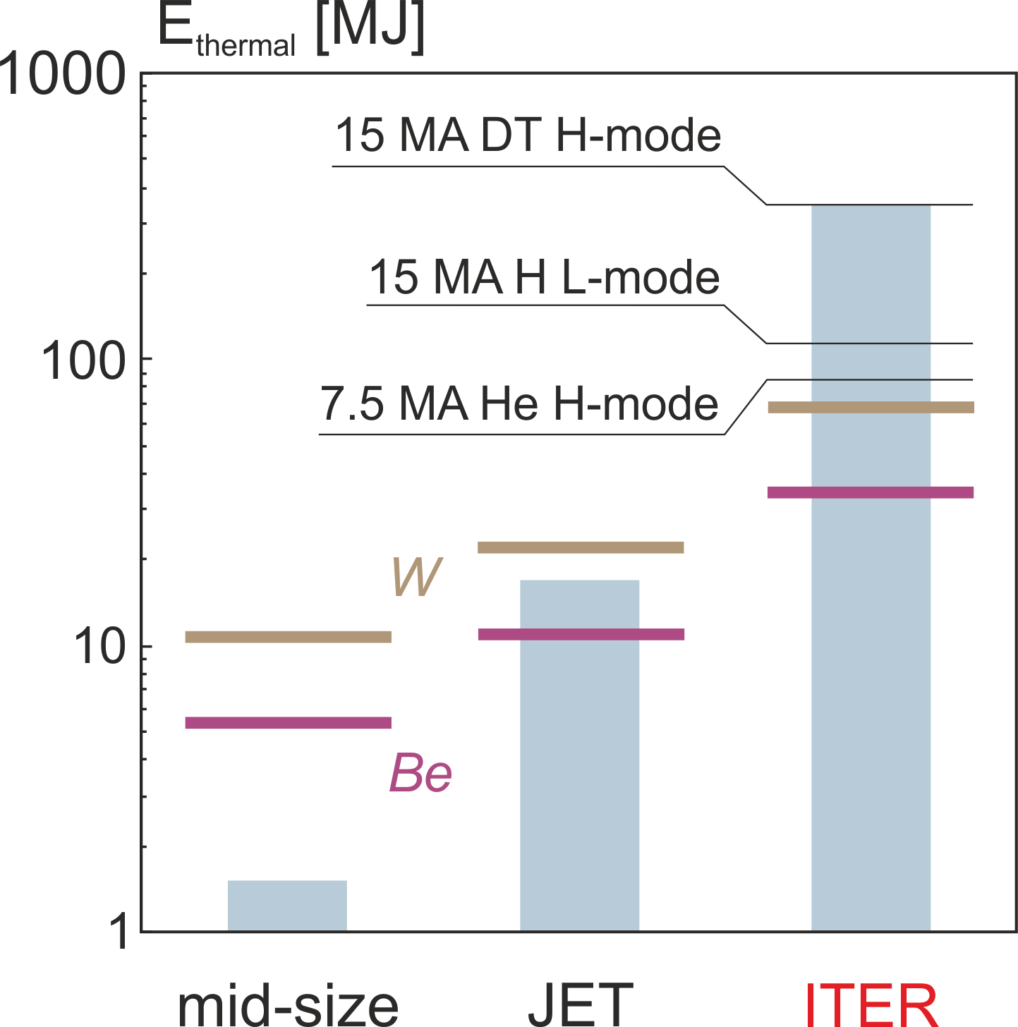
Why is mitigation required in ITER?
Thermal Energy
Beryllium
up to
350 MJ
$$E_{melt}\sim R^{3/2}$$
$$E_{thermal}\sim R^{5}$$
Tungsten
Melt limit: $t_{TQ}\sim R$; $A\sim Rλ;ΔT \sim E_{thermal}/A\sqrt{t_{TQ}}$ → $E_{melt}\sim R^{3/2}$

Slide 16
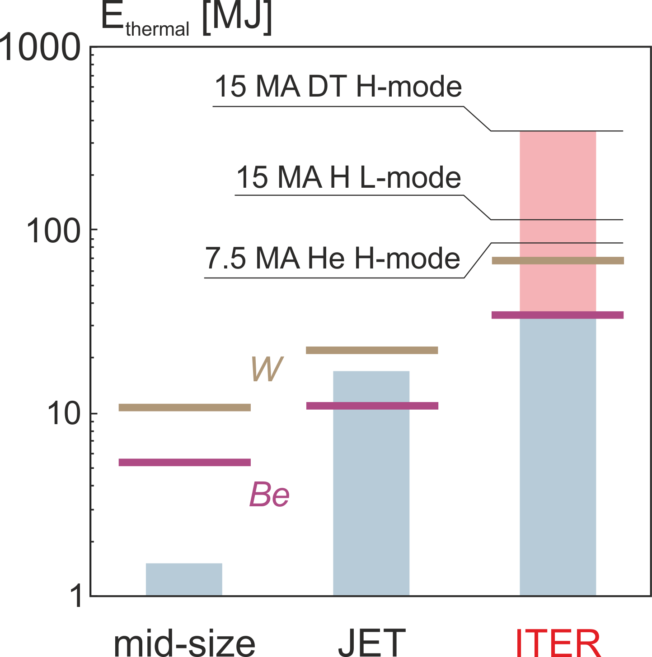
Why is mitigation required in ITER?
Thermal Energy
Beryllium
mitigation
up to
350 MJ
$$E_{melt}\sim R^{3/2}$$
$$E_{thermal}\sim R^{5}$$
Tungsten
Melt limit: $t_{TQ}\sim R$; $A\sim Rλ;ΔT \sim E_{thermal}/A\sqrt{t_{TQ}}$ → $E_{melt}\sim R^{3/2}$

Slide 17
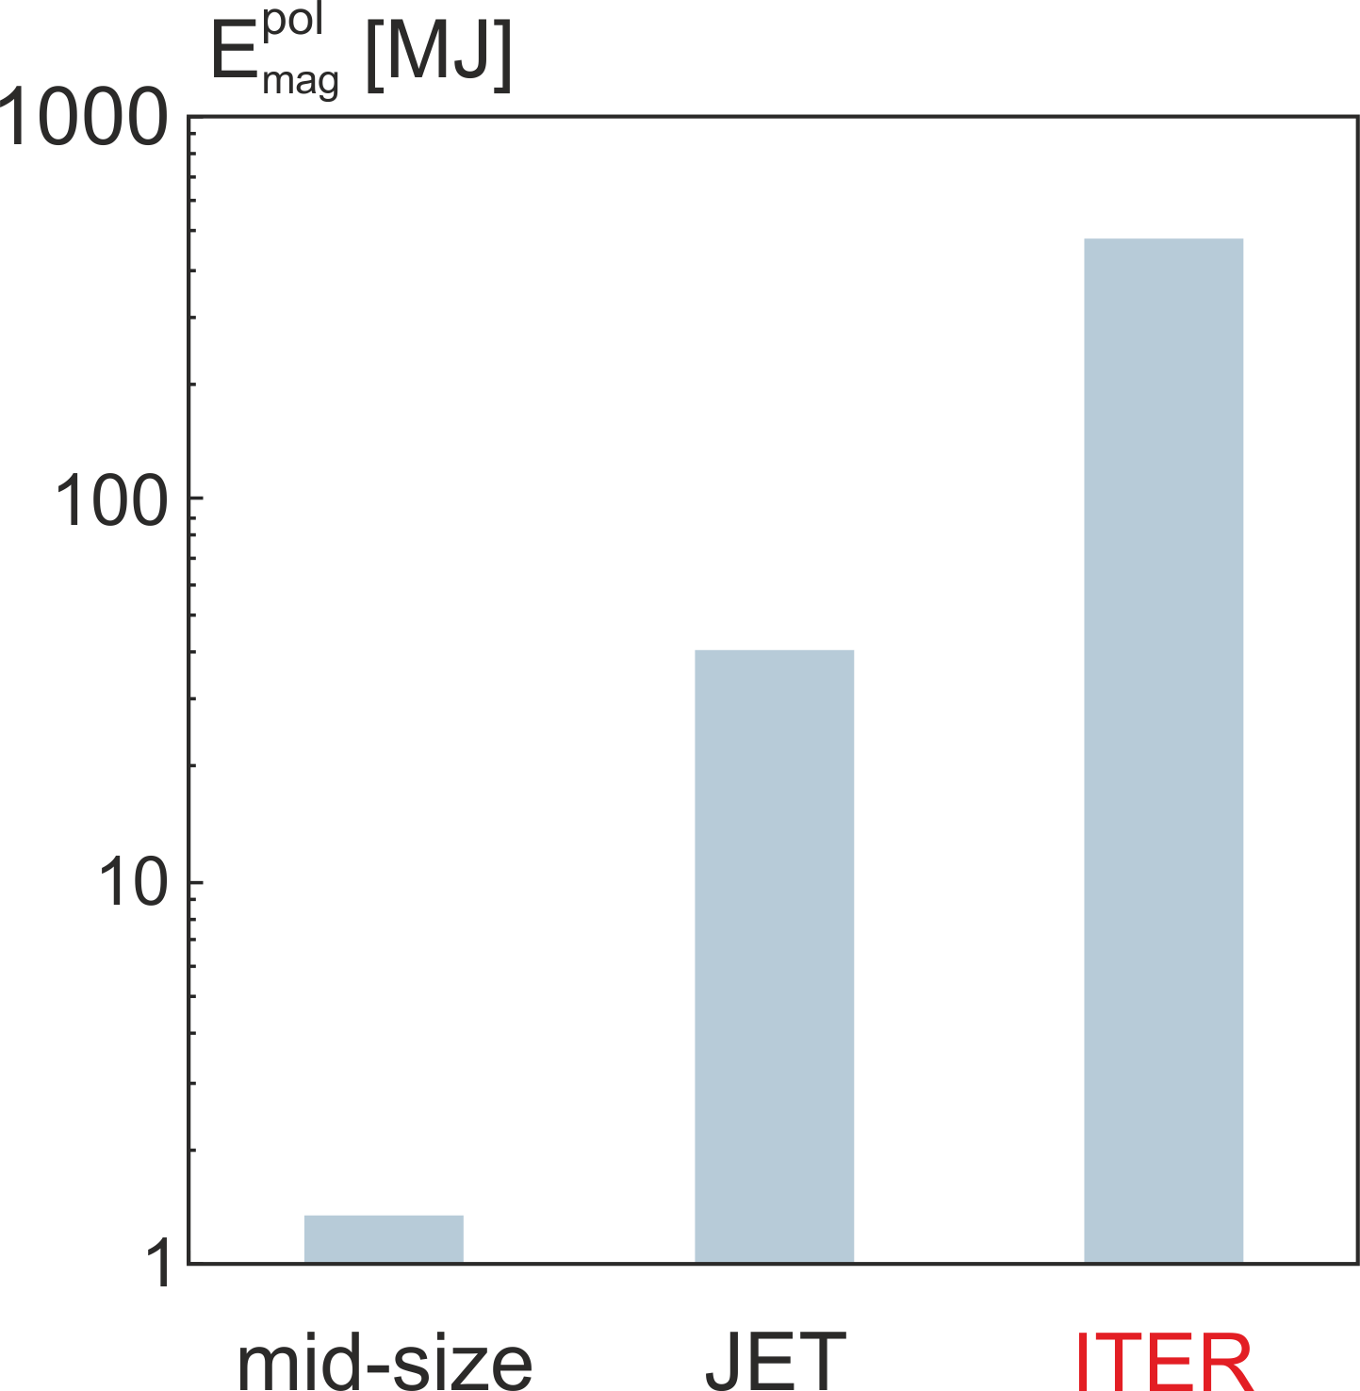

Magnetic Energy
Why is mitigation required in ITER?
1100 MJ
400 MJ
$$E_{mag}^{pol}\sim {B_{t}^{2}R}^{3}$$

Slide 18
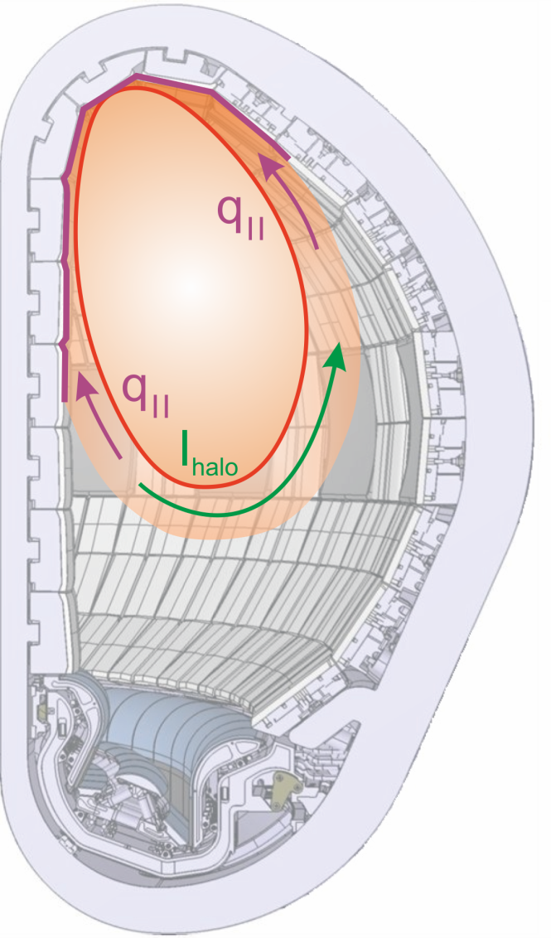

Magnetic Energy
Why is mitigation required in ITER?
$$P_{rad}≪P_{cond}$$
$$E_{mag}^{pol}\sim {B_{t}^{2}R}^{3}$$

Slide 19
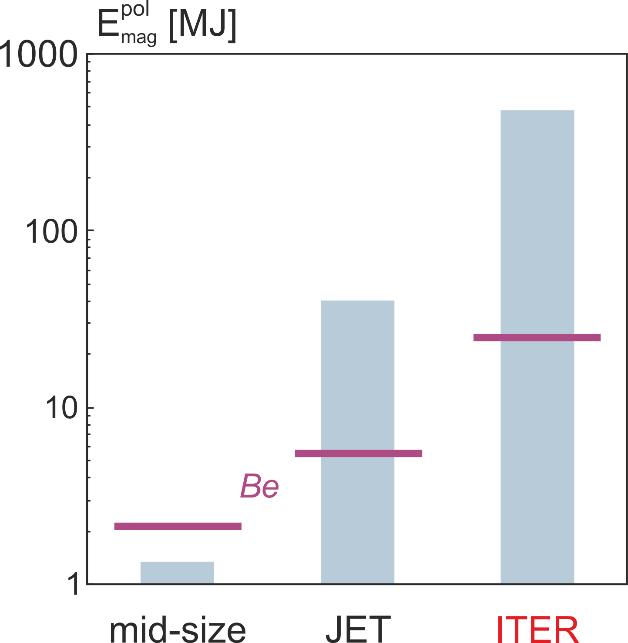
Magnetic Energy
Why is mitigation required in ITER?
$$P_{rad}≪P_{cond}$$
$$E_{mag}^{pol}\sim {B_{t}^{2}R}^{3}$$
Melt limit: $t_{vertical}\sim R2$; $A\sim Rλ;ΔT \sim E_{thermal}/A\sqrt{t_{TQ}}$ → $E_{melt}\sim R^{2}$

Slide 20
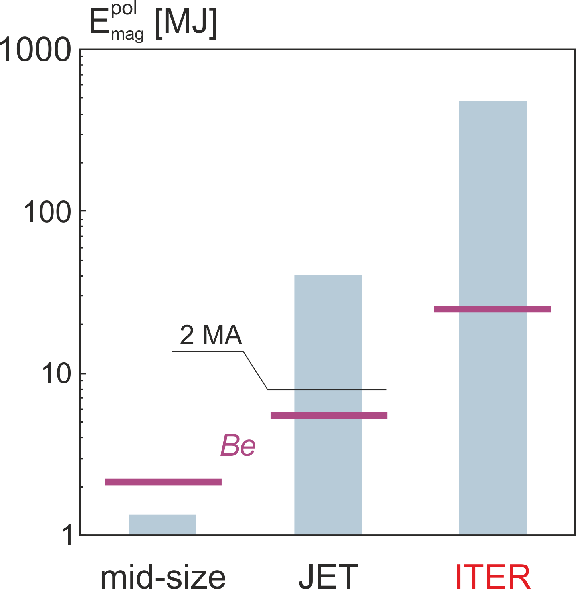
Magnetic Energy
Why is mitigation required in ITER?
$$P_{rad}≪P_{cond}$$
$$E_{mag}^{pol}\sim {B_{t}^{2}R}^{3}$$
Melt limit: $t_{vertical}\sim R2$; $A\sim Rλ;ΔT \sim E_{thermal}/A\sqrt{t_{TQ}}$ → $E_{melt}\sim R^{2}$

Slide 21
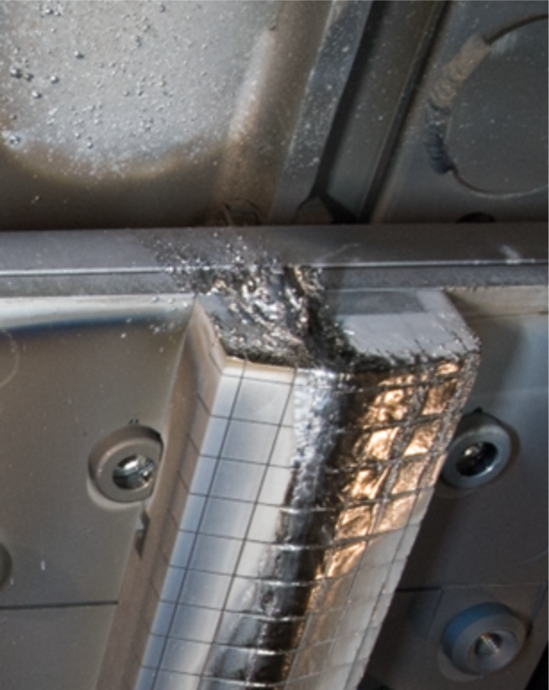
Magnetic Energy
Why is mitigation required in ITER?
$$P_{rad}≪P_{cond}$$
JET Be dump plates
G.F. Matthews, Phys.Scr. 2016
$$E_{mag}^{pol}\sim {B_{t}^{2}R}^{3}$$
Melt limit: $t_{vertical}\sim R2$; $A\sim Rλ;ΔT \sim E_{thermal}/A\sqrt{t_{TQ}}$ → $E_{melt}\sim R^{2}$

Slide 22
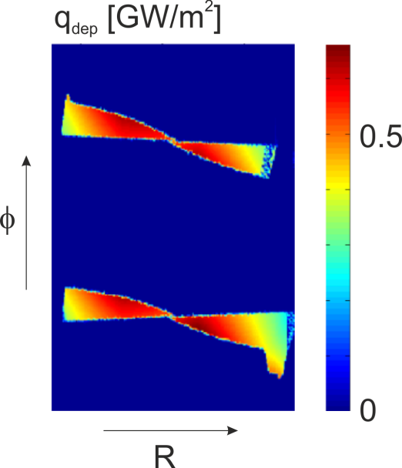
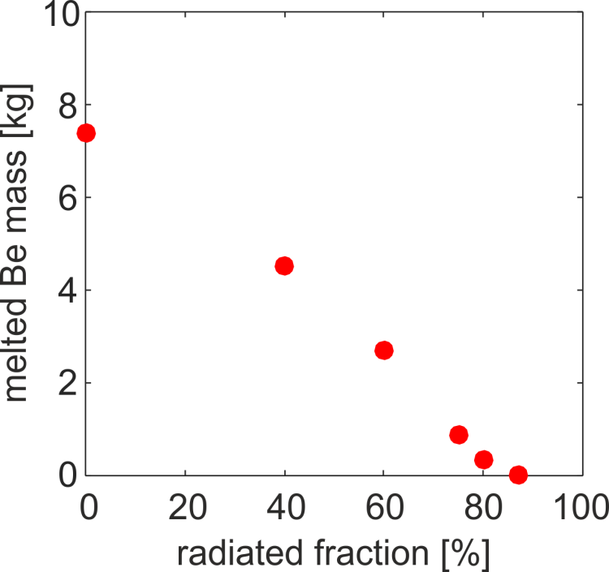
Magnetic Energy
Why is mitigation required in ITER?
Field line mapping
$$P_{rad}≪P_{cond}$$
15 MA major disruption
$$E_{mag}^{pol}\sim {B_{t}^{2}R}^{3}$$
Melt limit: $t_{vertical}\sim R2$; $A\sim Rλ;ΔT \sim E_{thermal}/A\sqrt{t_{TQ}}$ → $E_{melt}\sim R^{2}$

Slide 23
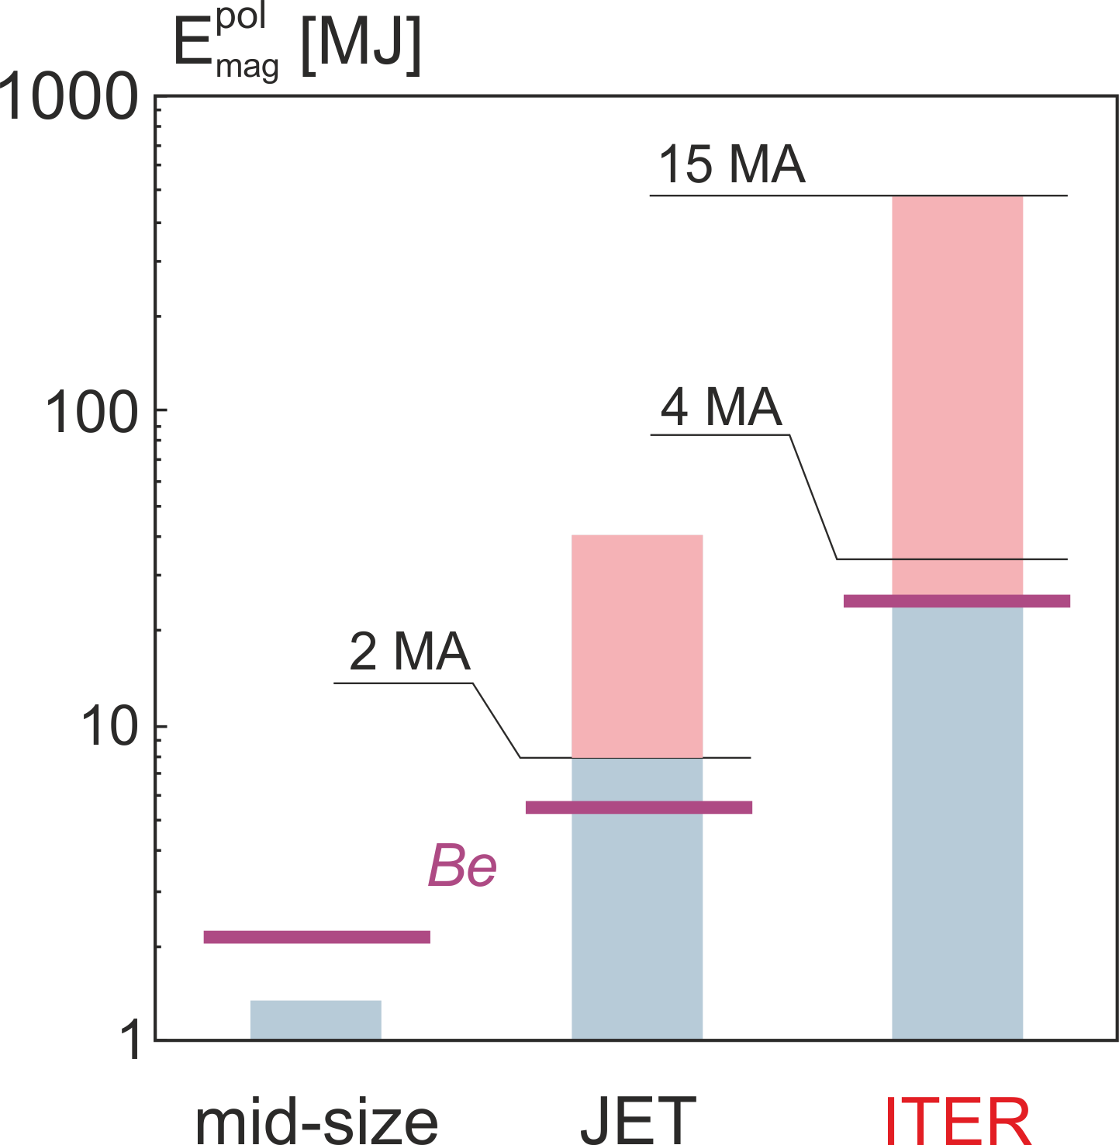
Magnetic Energy
Why is mitigation required in ITER?
$$P_{rad}≪P_{cond}$$
mitigation
$$E_{mag}^{pol}\sim {B_{t}^{2}R}^{3}$$
Melt limit: $t_{vertical}\sim R2$; $A\sim Rλ;ΔT \sim E_{thermal}/A\sqrt{t_{TQ}}$ → $E_{melt}\sim R^{2}$

Slide 24
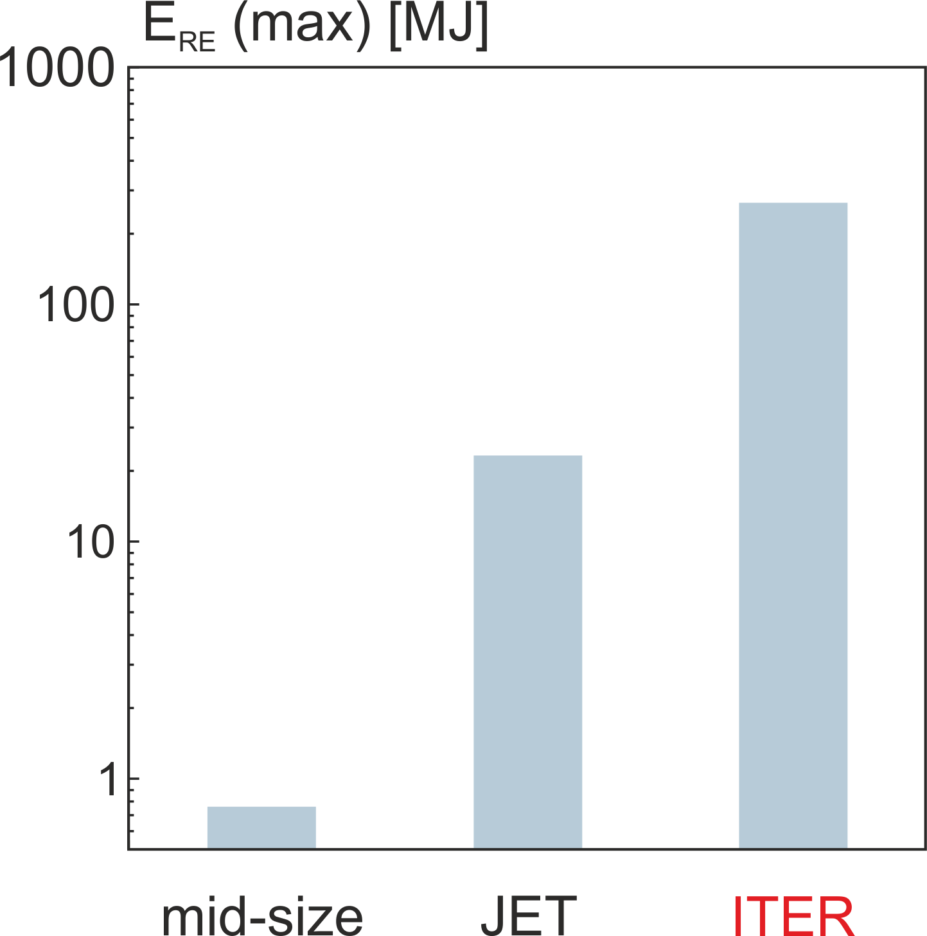
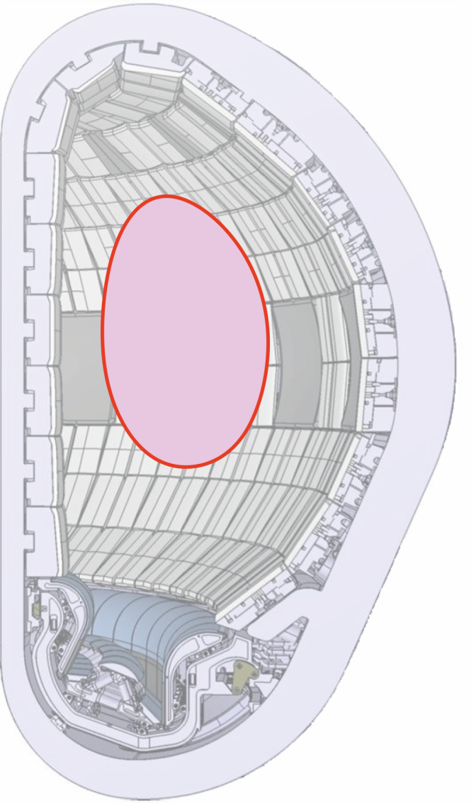

Why is mitigation required in ITER?
Runaway Electrons
$$E_{RE}\sim E_{mag}^{pol}\sim {B_{t}^{2}R}^{3}$$

Slide 25
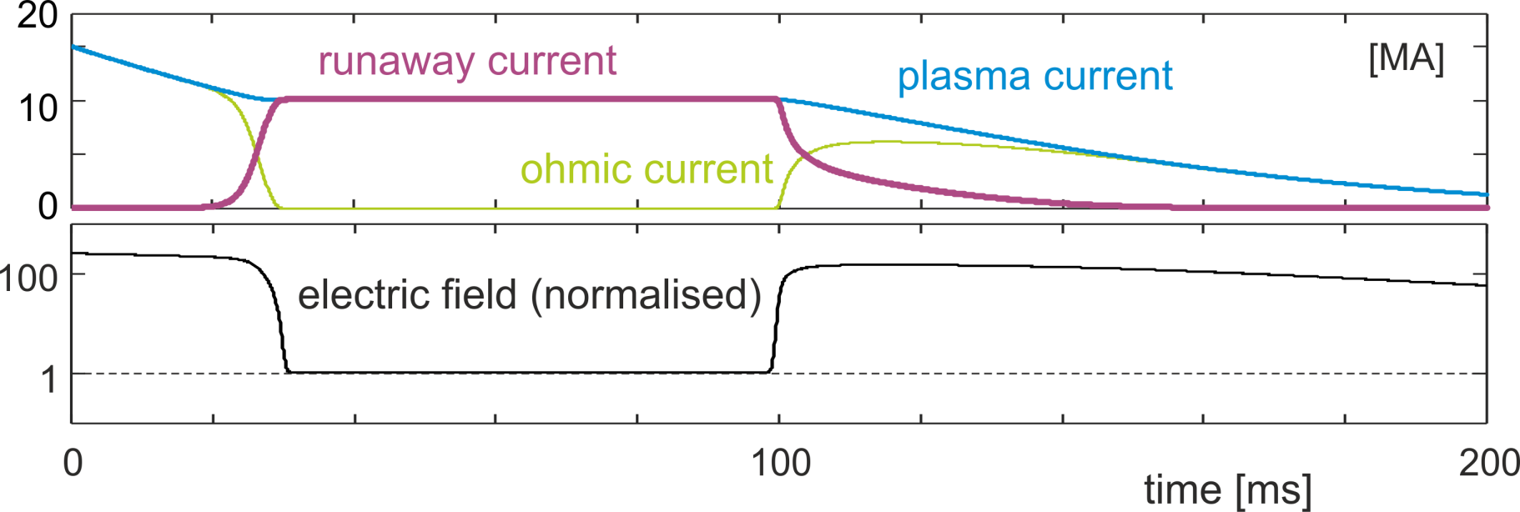
Runaway electron life cycle
0D simulation

Slide 26
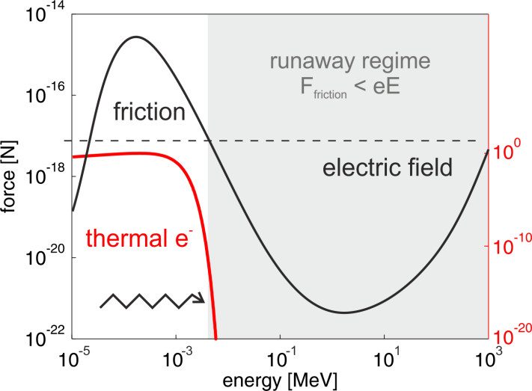
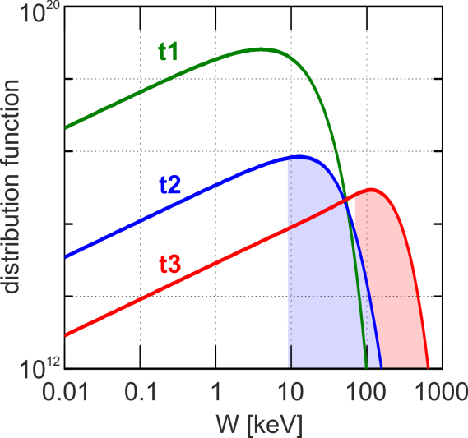
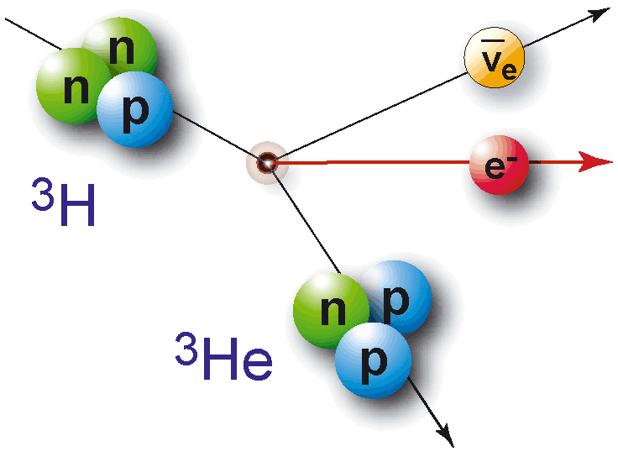
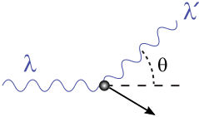
Runaway electron life cycle
e⁻
Tritium
decay
Compton
scattering
Dreicer
Hot tail
0D simulation

Slide 27

Runaway electron life cycle
Avalanche multiplication $\sim exp(I_{P})$
0D simulation

Slide 28

Runaway electron life cycle
Runaway plateau phase (kinetic energy $\sim$20 MJ)
0D simulation

Slide 29
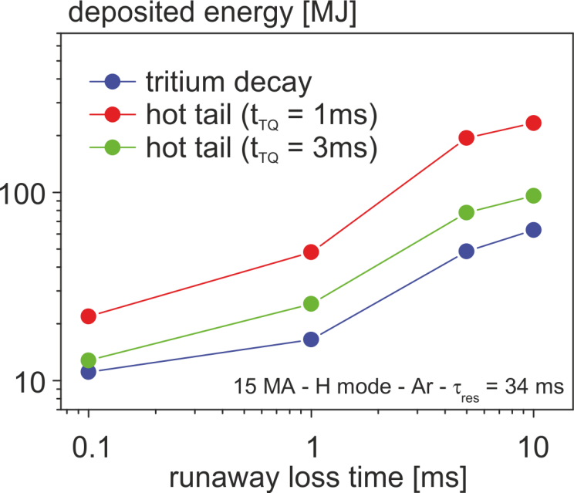
Runaway electron life cycle
Runaway loss phase: magnetic energy conversion (up to 300 MJ)
J.R. Martín-Solís, Nucl. Fusion 2017
0D simulation

Slide 30
Why is mitigation required in ITER?
Runaway Electrons
$$E_{RE}\sim E_{mag}^{pol}\sim {B_{t}^{2}R}^{3}$$

Slide 31
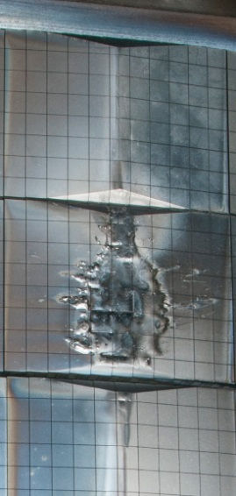
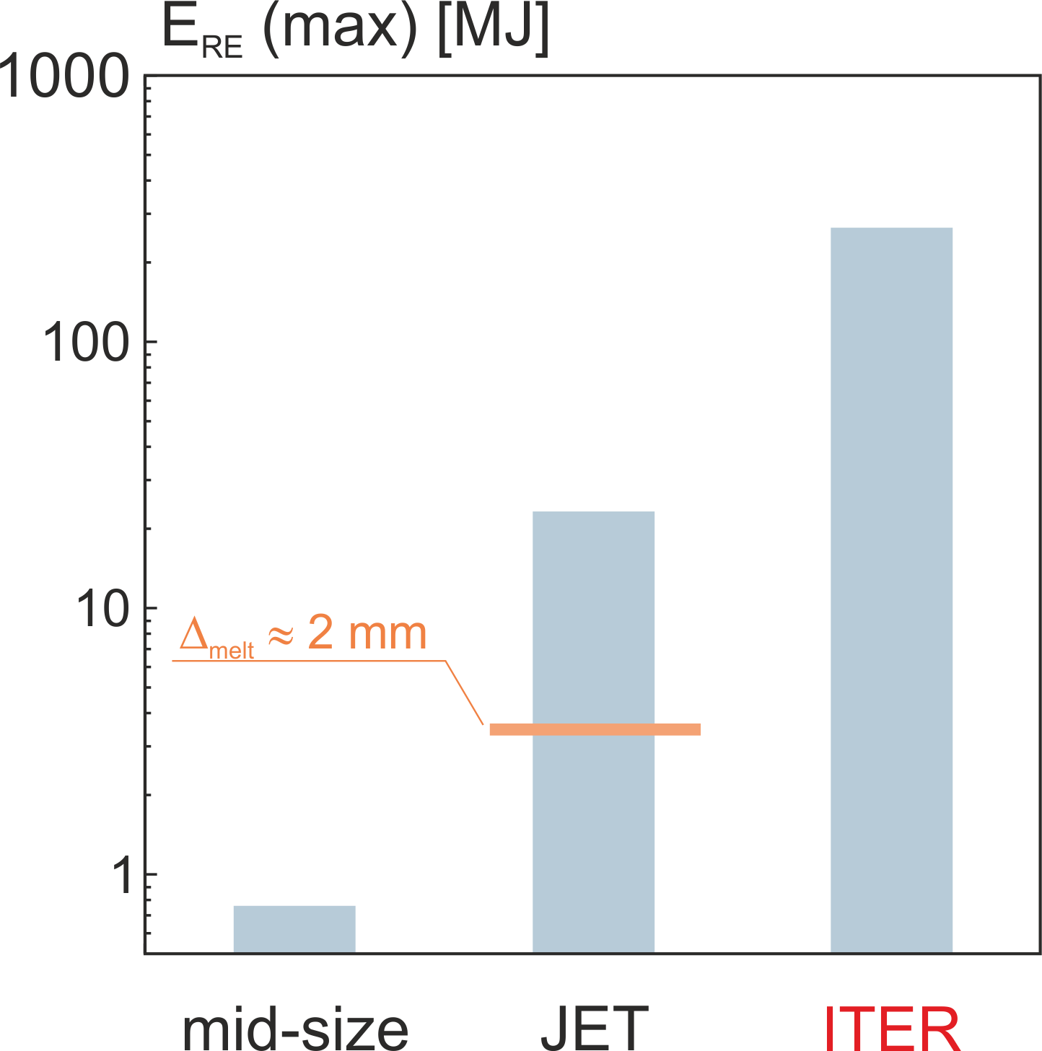
Why is mitigation required in ITER?
Runaway Electrons
$$E_{RE}\sim E_{mag}^{pol}\sim {B_{t}^{2}R}^{3}$$
JET inner limiter
I_{RE} ≈ 0.9 MA
G.F. Matthews, Phys.Scr. 2016

Slide 32
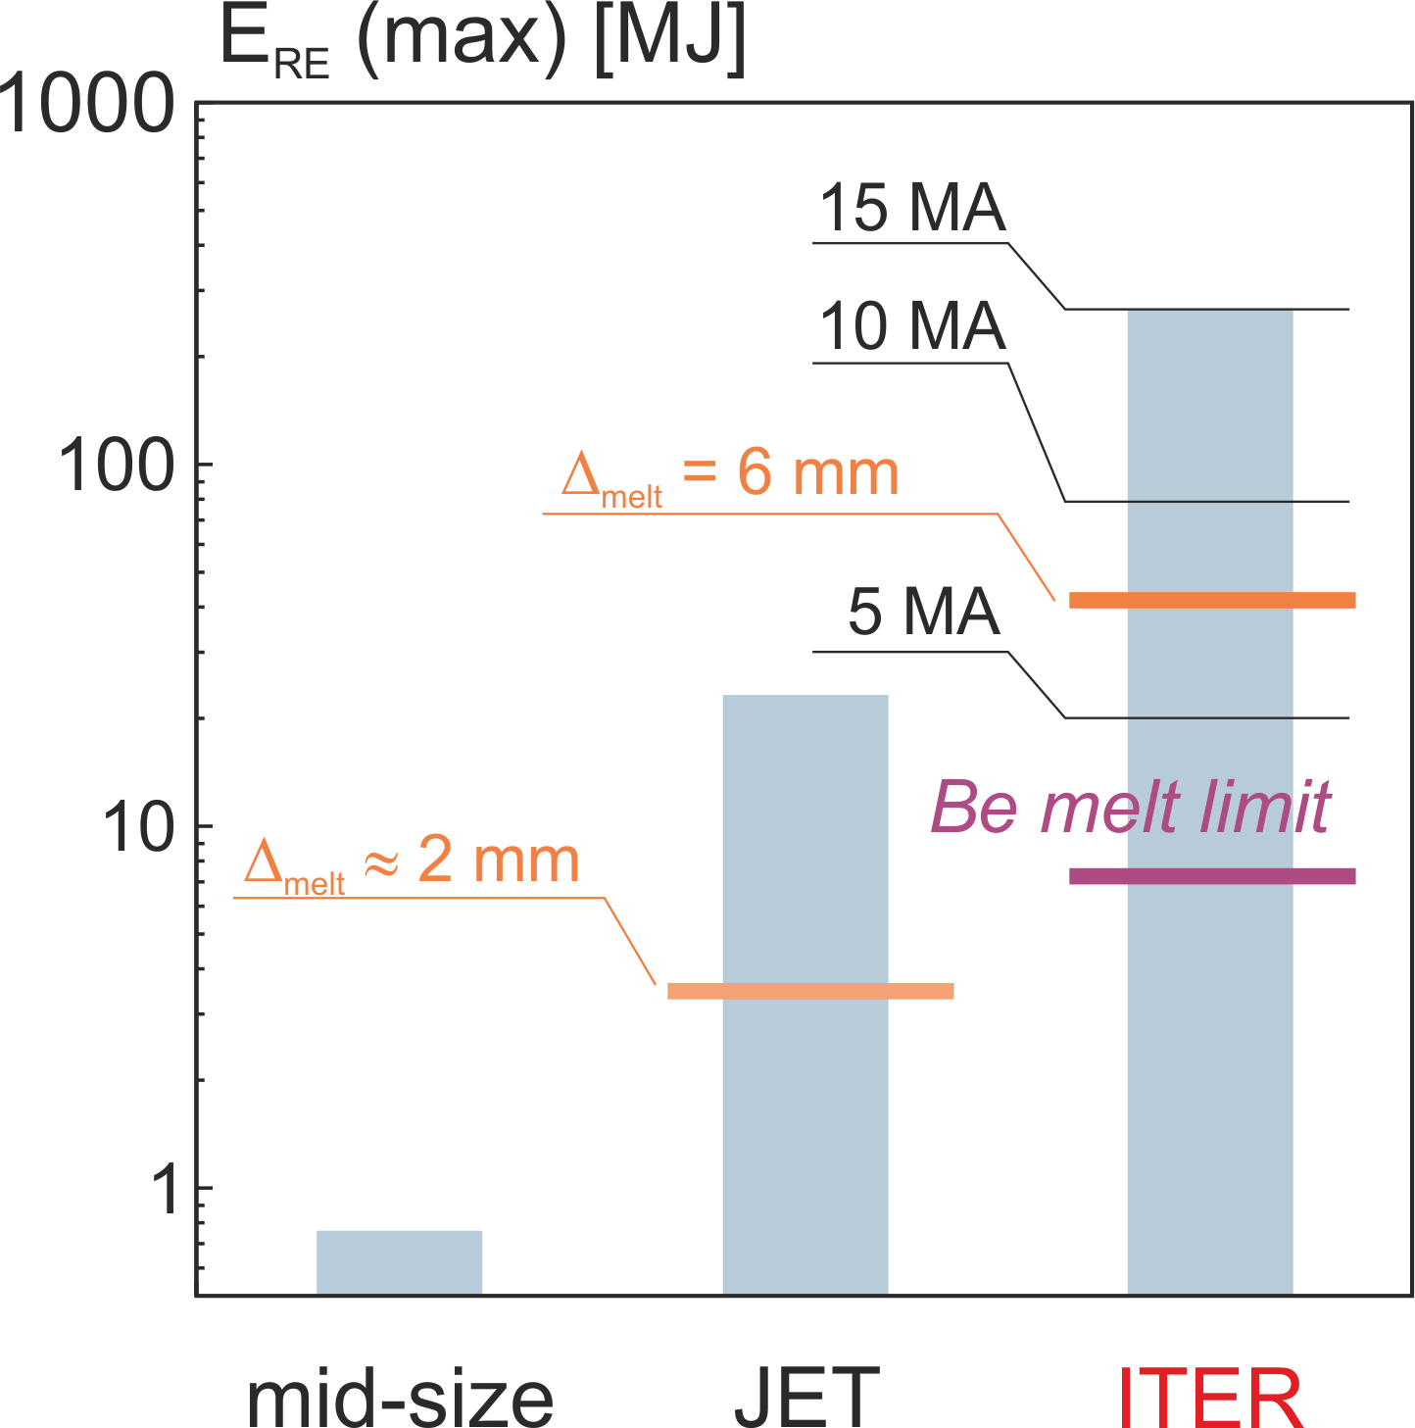
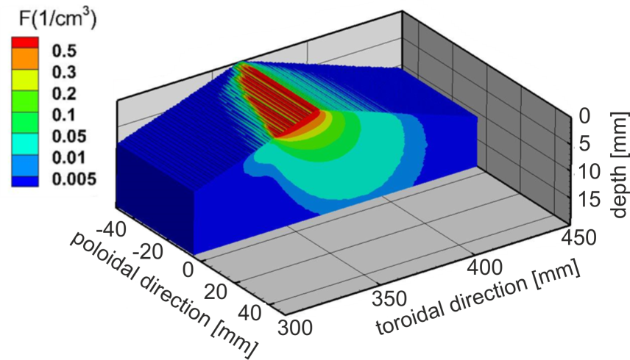
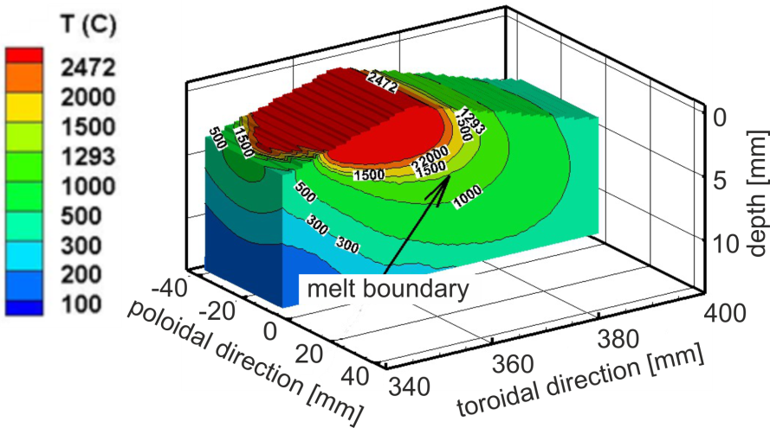
Why is mitigation required in ITER?
Runaway Electrons
ITER simulations
$$E_{RE}\sim E_{mag}^{pol}\sim {B_{t}^{2}R}^{3}$$

Slide 33
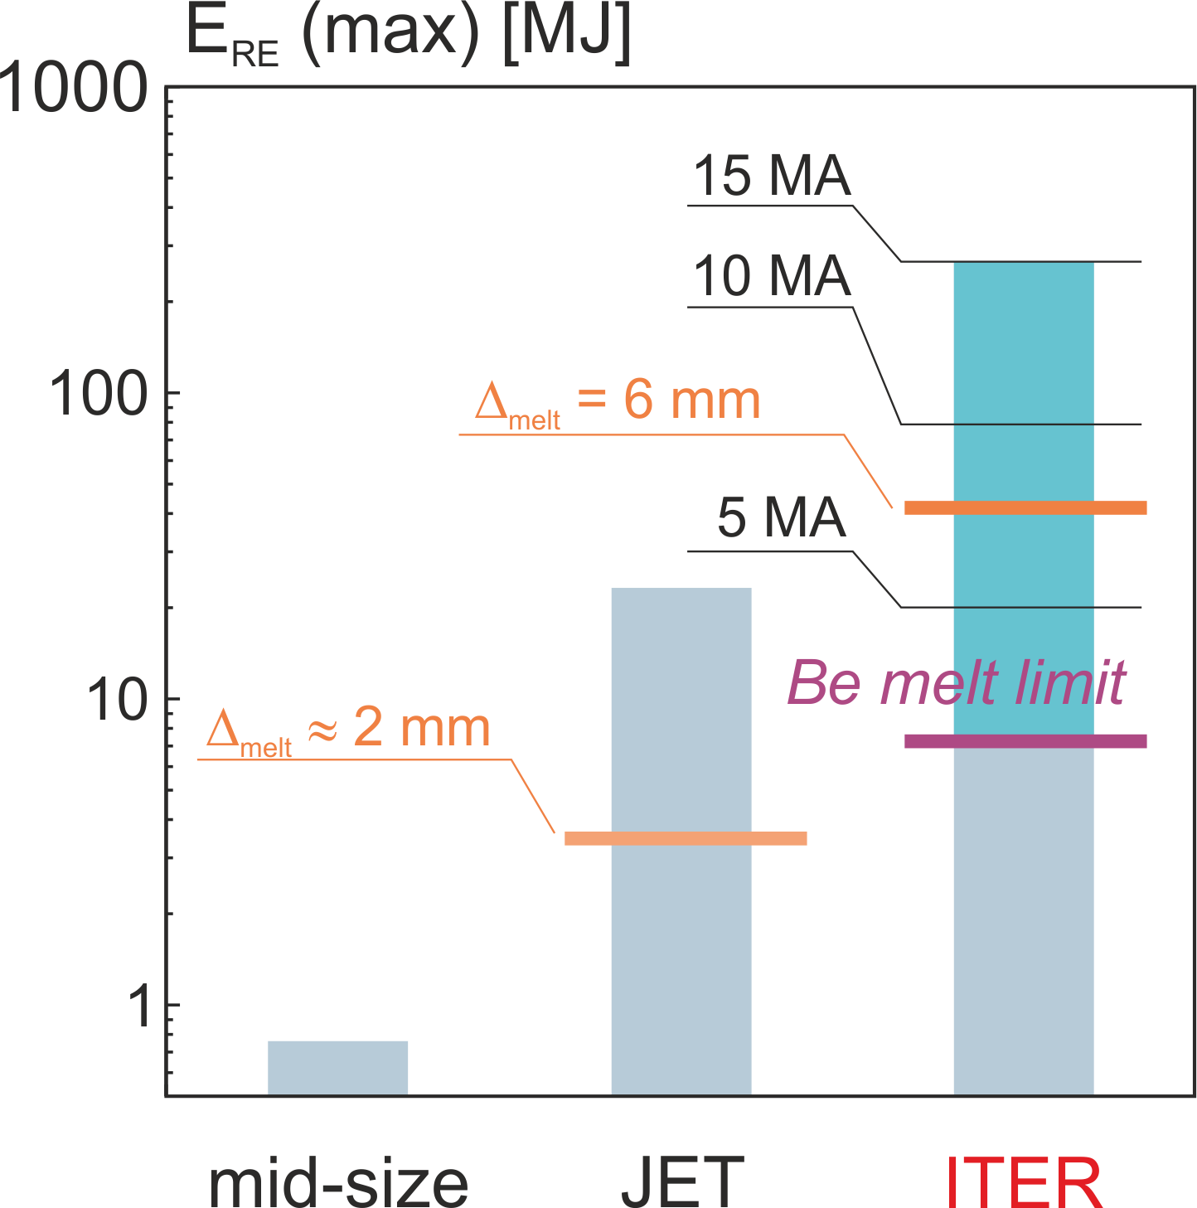
Why is mitigation required in ITER?
Runaway Electrons
avoidance
$$E_{RE}\sim E_{mag}^{pol}\sim {B_{t}^{2}R}^{3}$$

Slide 34
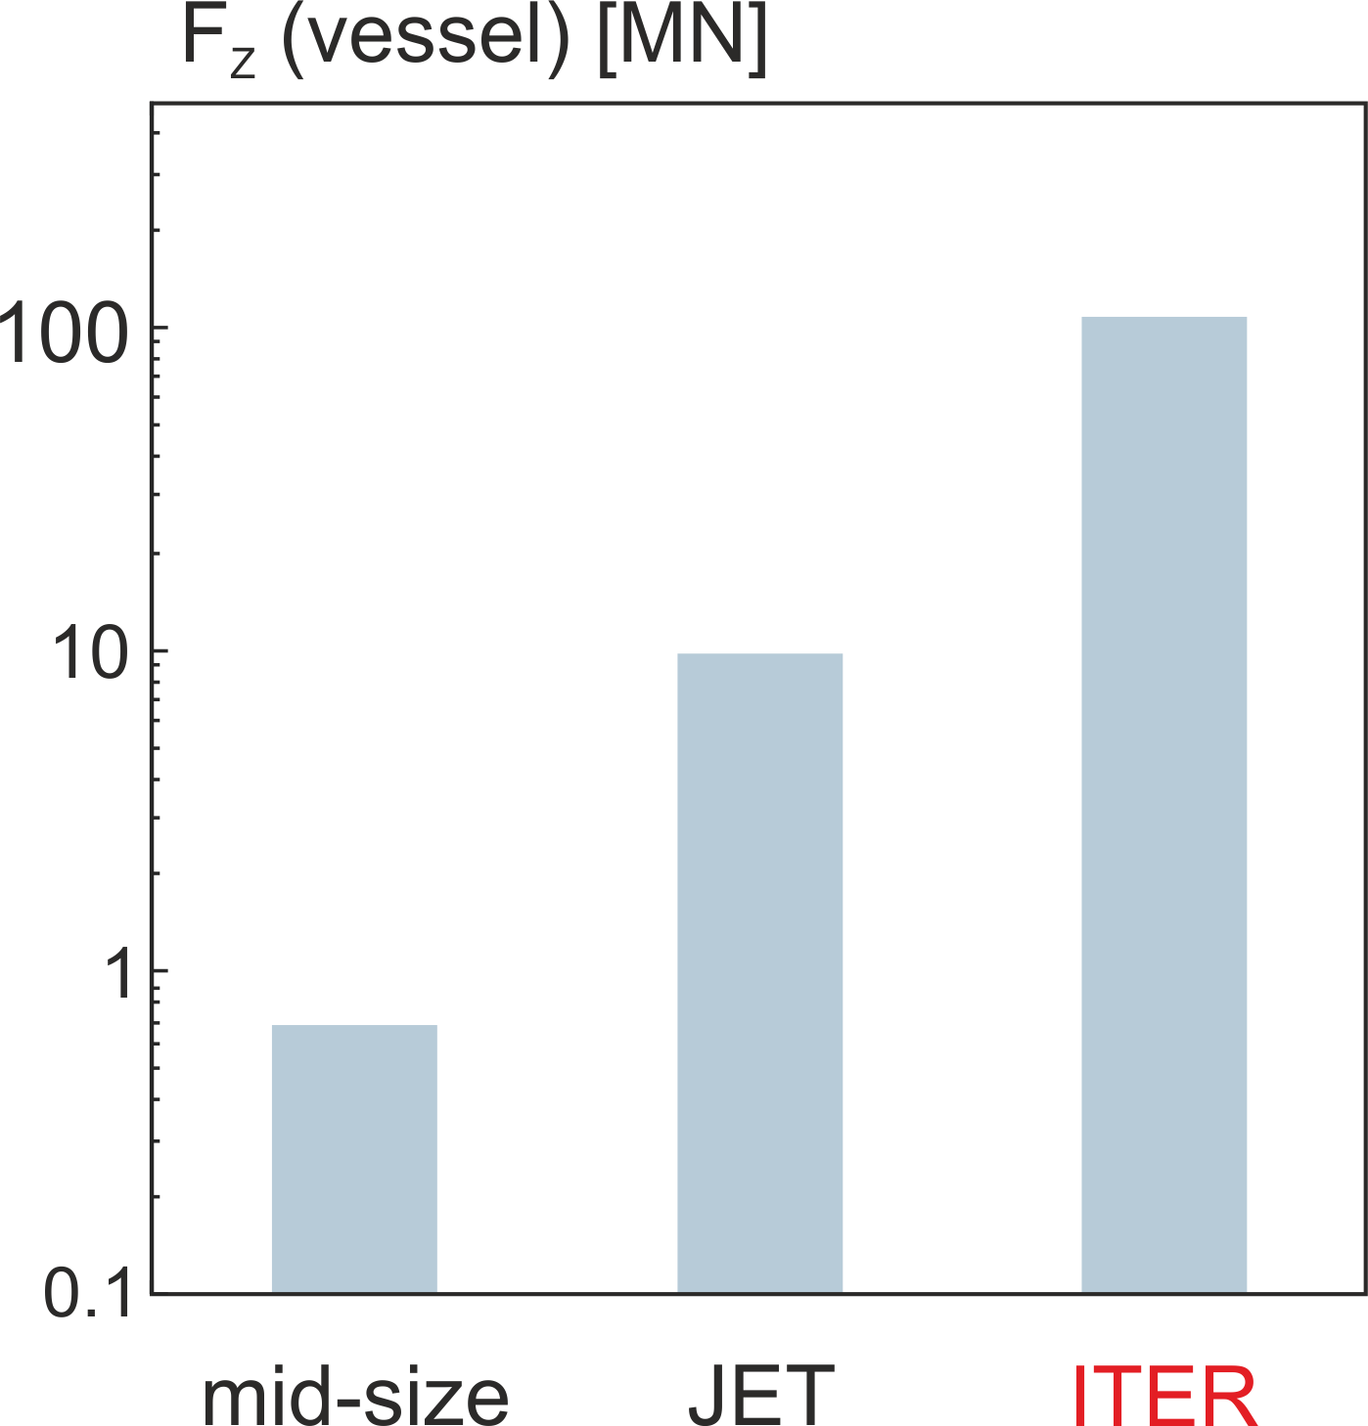
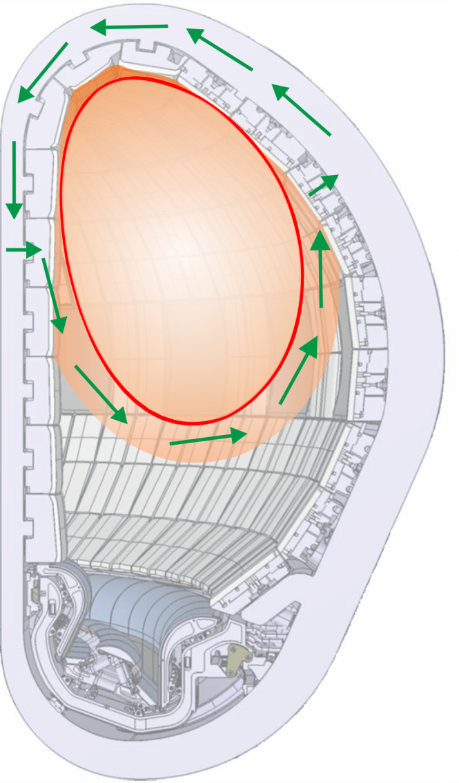

Why is mitigation required in ITER?
Electromagnetic Forces
F_{z}
B_{t}
$$I_{halo}$$
Force on the vacuum vessel: F_{Z} = F_{eddy} + F_{halo} ; F_{halo} > F_{eddy} (ITER)

Slide 35
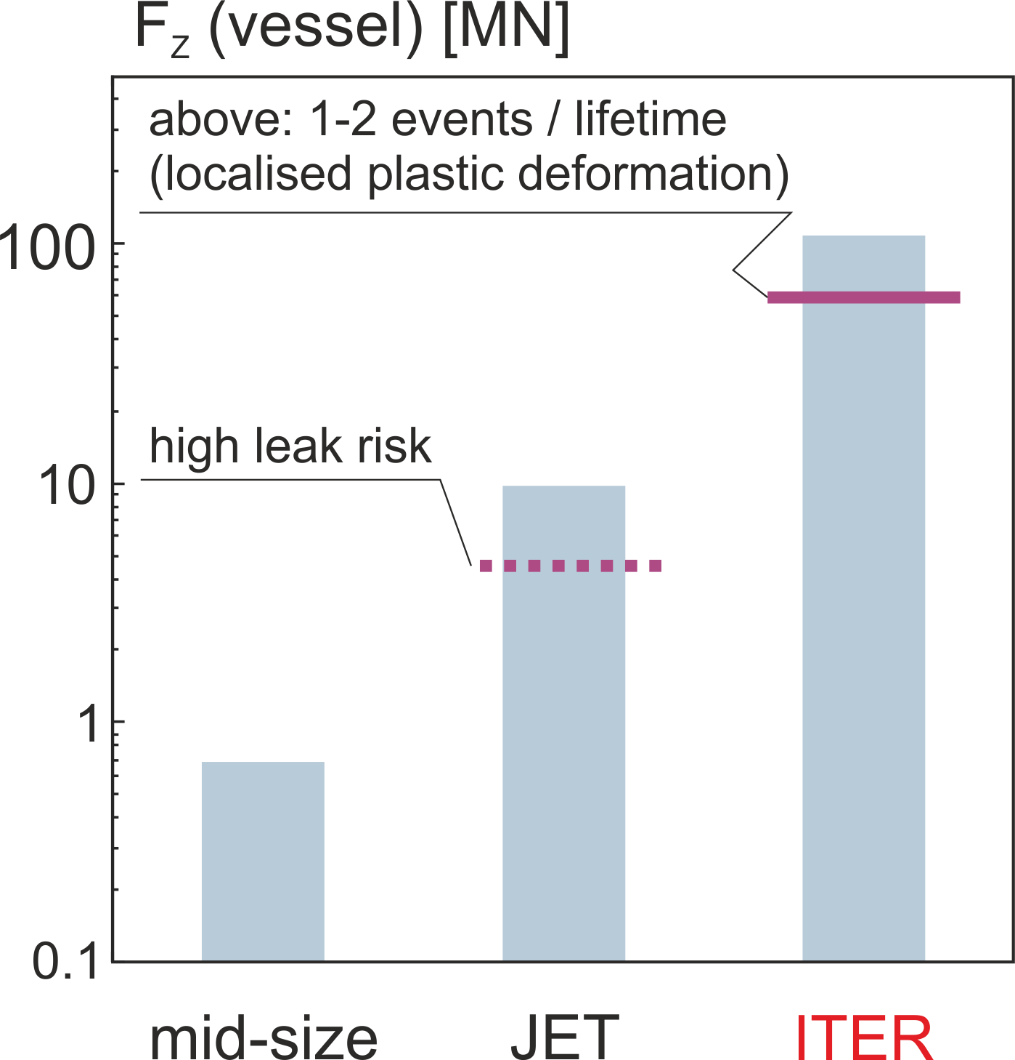
Why is mitigation required in ITER?
Electromagnetic Forces
F_{z}
B_{t}
$$I_{halo}$$

Slide 36
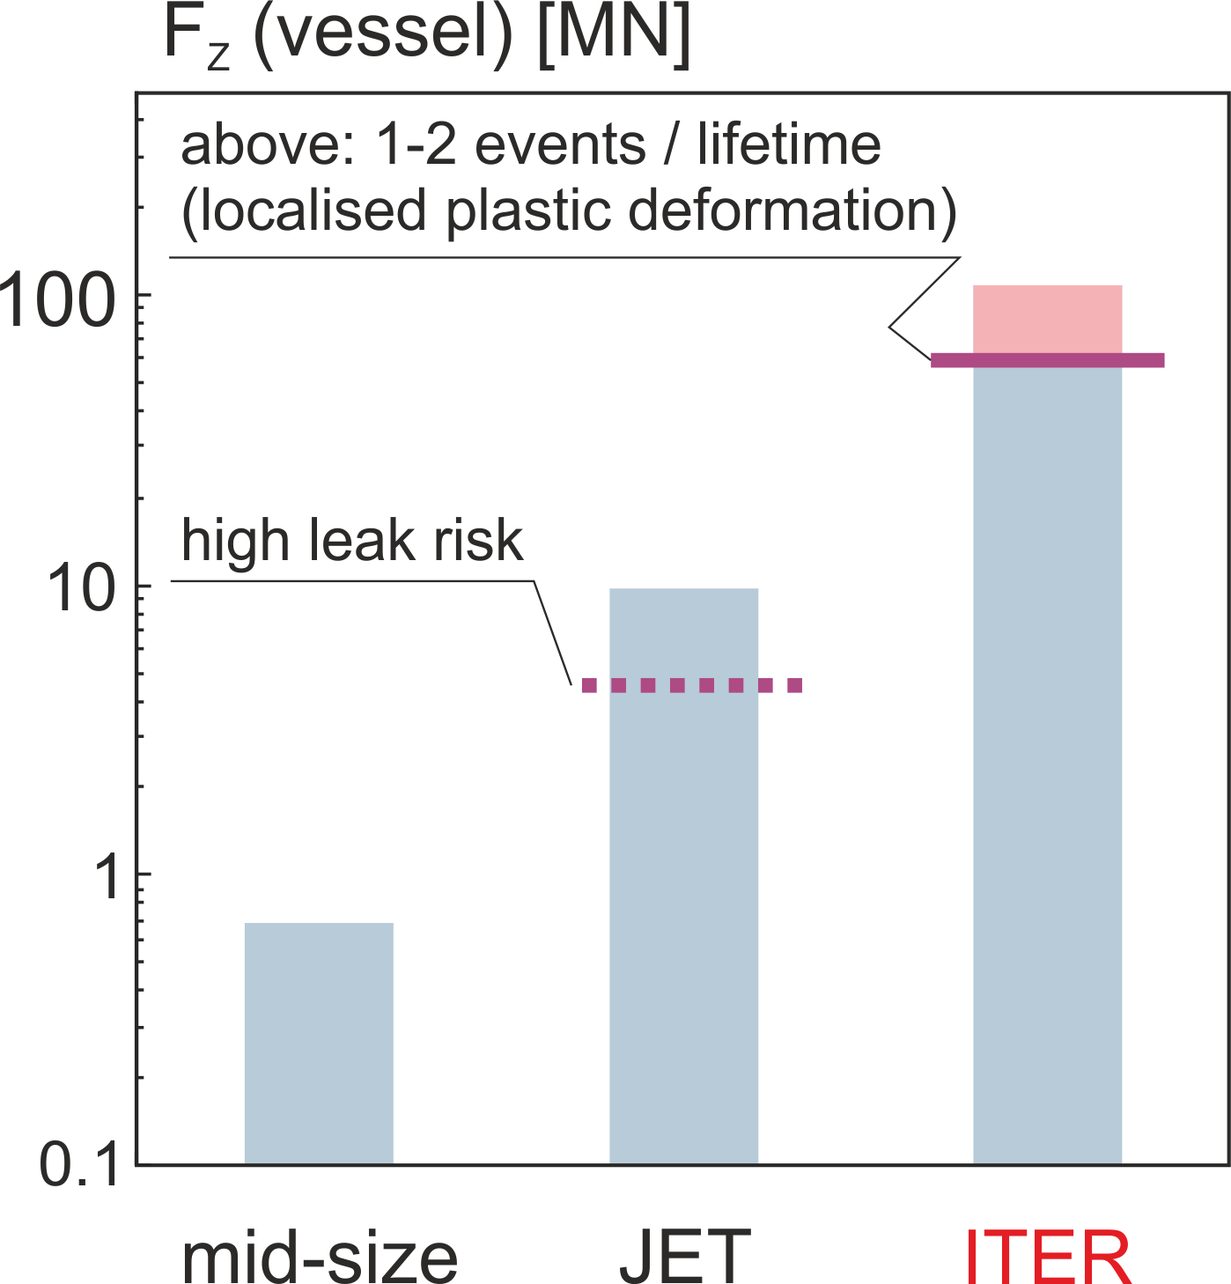
Why is mitigation required in ITER?
Electromagnetic Forces
F_{z}
B_{t}
$$I_{halo}$$
I_{halo}
reduction
The ITER vacuum vessel is the first confinement barrier and this function is preserved even for the highest unmitigated force

Slide 37
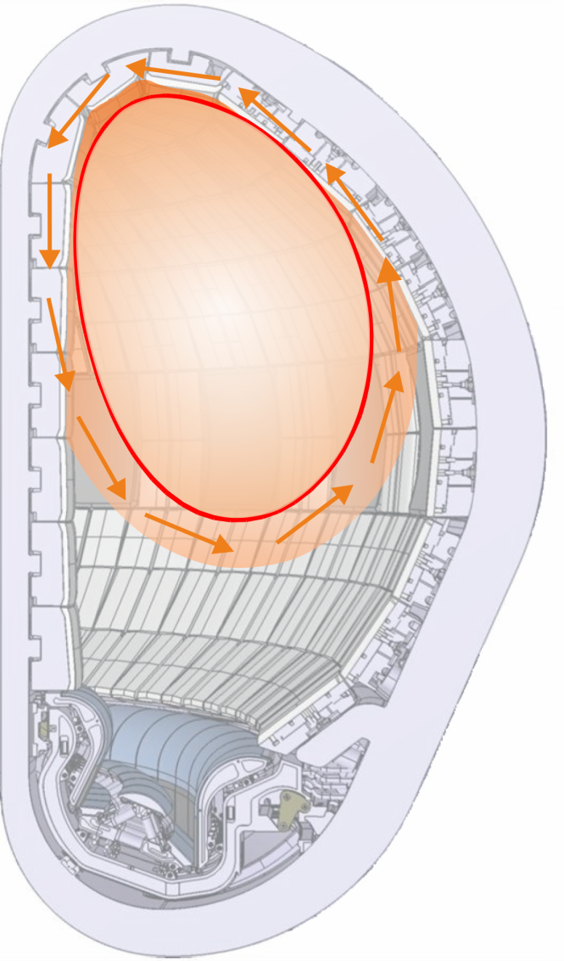
Why is mitigation required in ITER?
Electromagnetic Forces
dB/dt
dI_{P}/dt

Slide 38

Why is mitigation required in ITER?
Electromagnetic Forces
$$I_{eddy}$$
dB/dt
B_{t}
dB/dt
dI_{P}/dt
M_{z}
Moment on blanket modules limits allowable current decay rates

Slide 39
Control Disruption rate and
achieve high mitigation success rates

Slide 40
Disruption Management
Disruption Mitigation is required from early operation onward.
The number of unmitigated disruptions is controlled by containing the disruption rate (disruption avoidance) and maximising the mitigation success rate (disruption prediction and system reliability).
How many unmitigated and mitigated disruptions are acceptable at what energy and current?
The Disruption Budget Consumption is introduced as a lifetime consumption indicator.

Slide 41
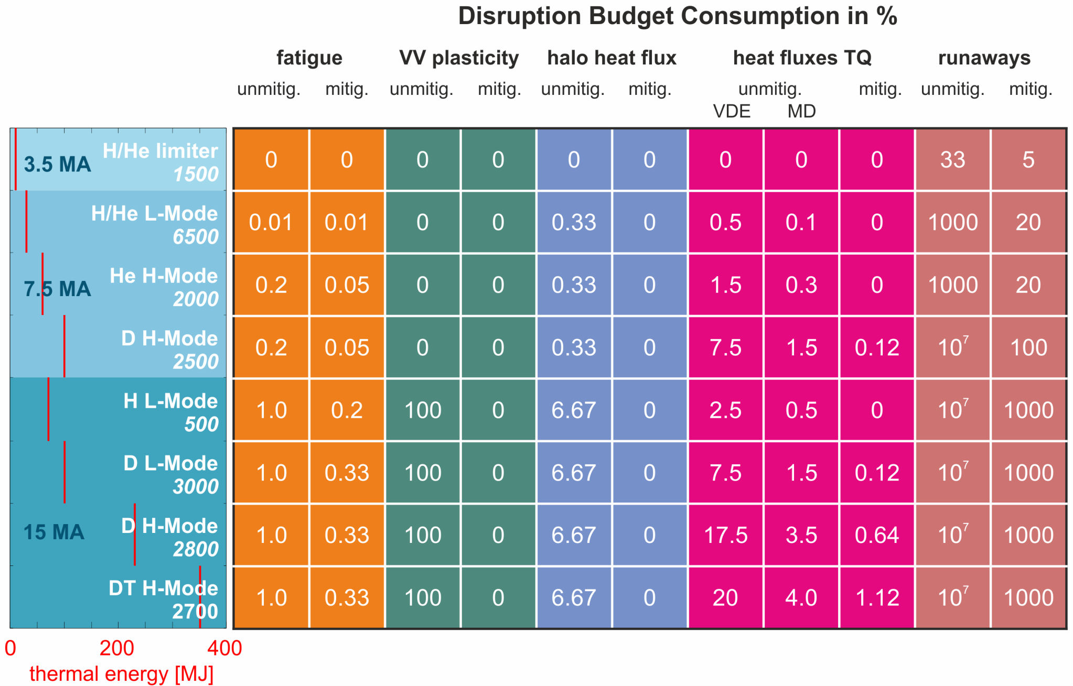
Disruption Budget
Based on pre-2017 ITER research plan

Slide 42
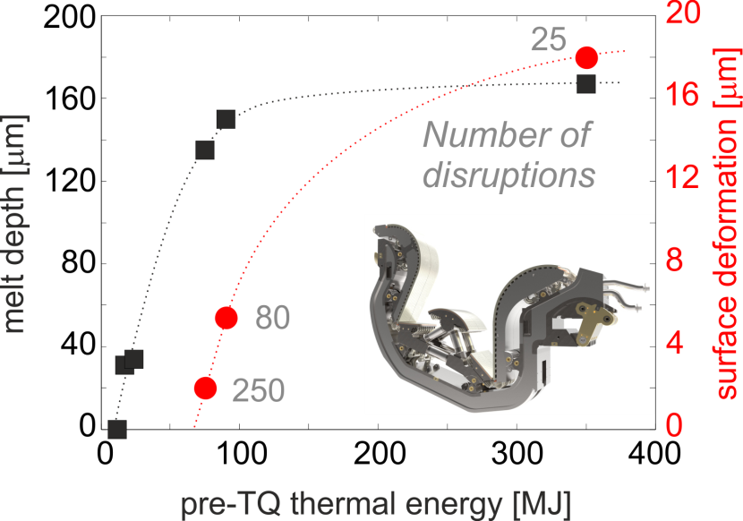
Disruption Budget
Based on pre-2017 ITER research plan

Slide 43
Disruption Budget
Conservative assumption: unmitigated disruptions at high current always generate high halo currents
Based on pre-2017 ITER research plan

Slide 44
Disruption Budget
Mitigation is load reduction, but not load avoidance!
Here: photonic radiation flash
Based on pre-2017 ITER research plan

Slide 45
Disruption Budget
Based on pre-2017 ITER research plan

Slide 46
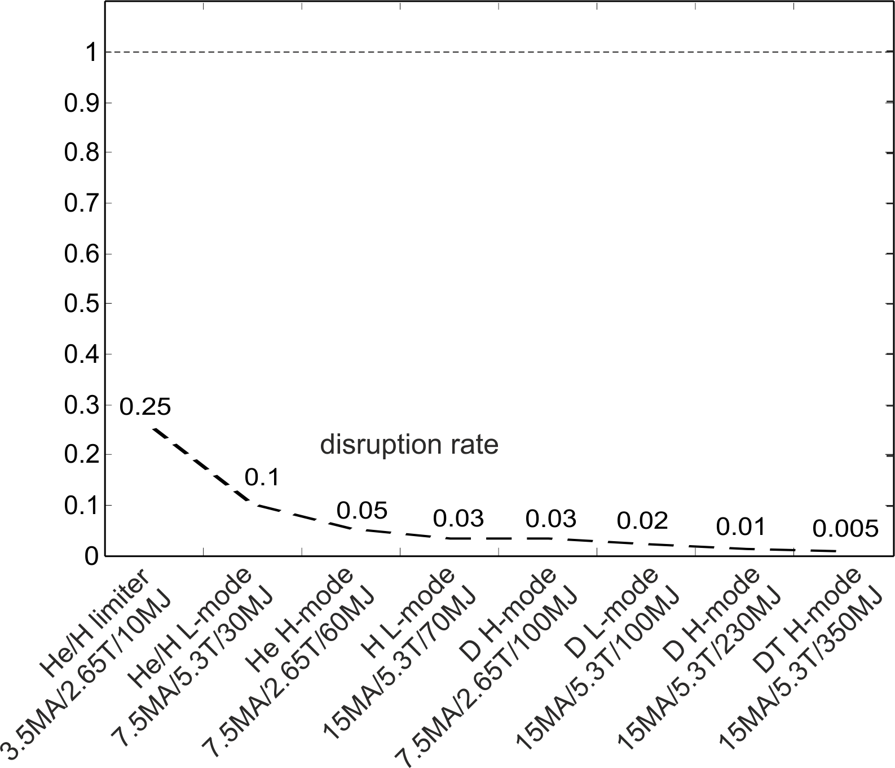
Disruption rate and mitigation targets
Based on pre-2017 ITER research plan

Slide 47
Disruption rate and mitigation targets
JET - ILW
P.C.de Vries, PoP 2014
3.3%
Based on pre-2017 ITER research plan

Slide 48
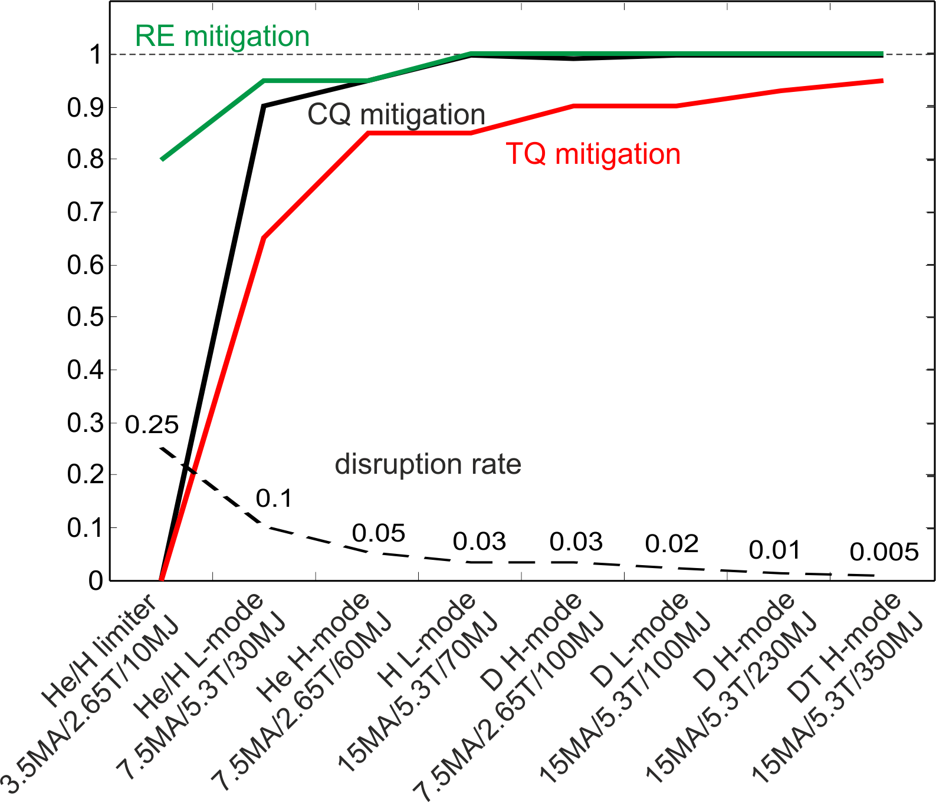
Disruption rate and mitigation targets
Based on pre-2017 ITER research plan

Slide 49
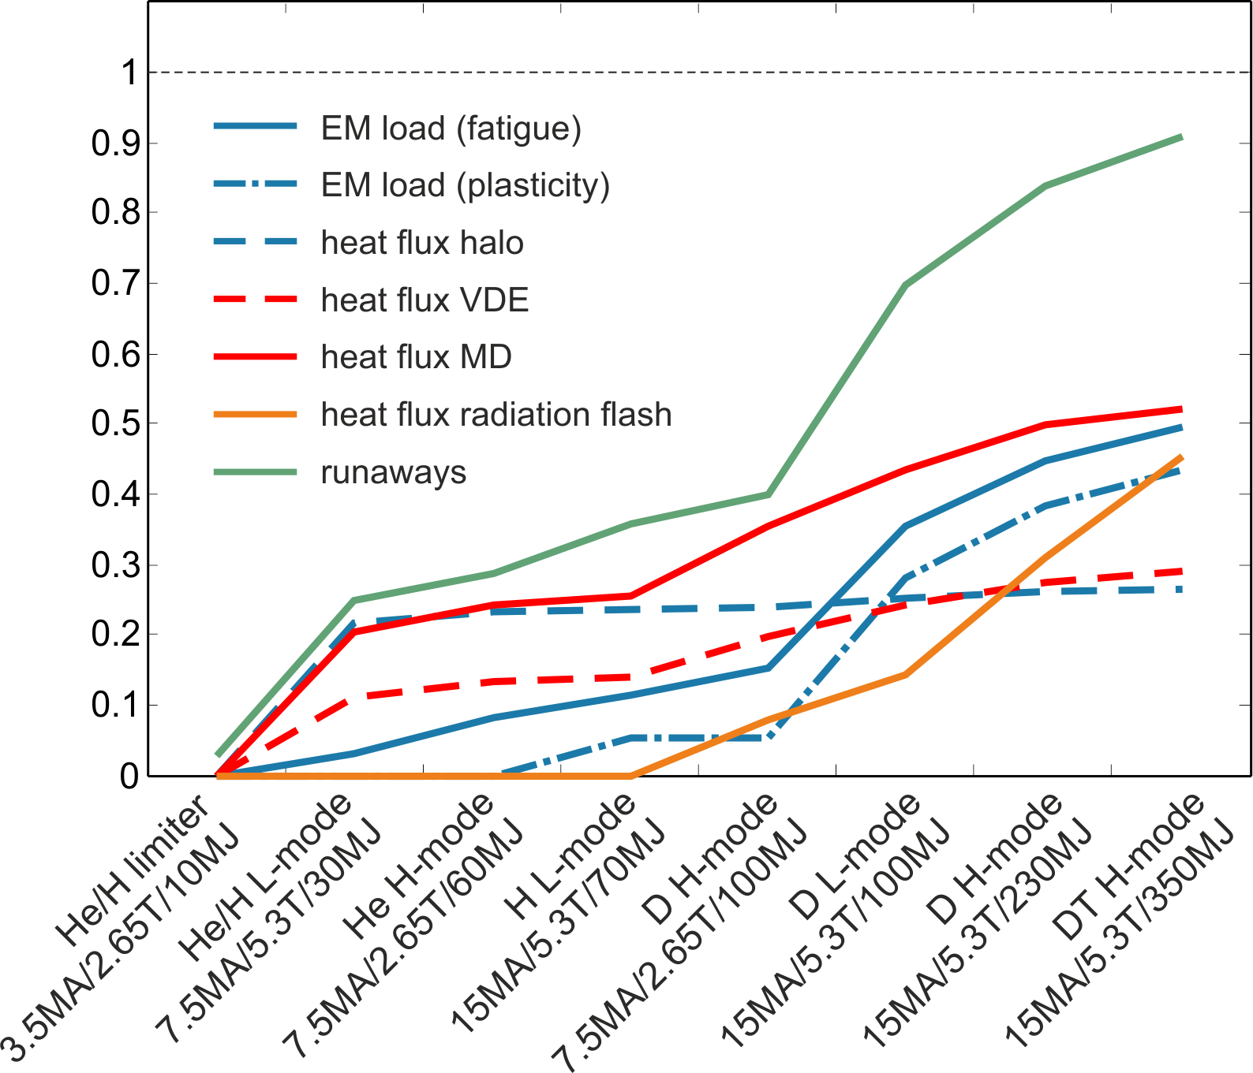
Disruption rate and mitigation targets
Lifetime consumption
Based on pre-2017 ITER research plan

Slide 50
Disruption Mitigation

Slide 51

Mitigation of heat loads and electro-magnetic forces
Injection of high-Z impurities
Dissipate thermal and magnetic energy through photonic radiation

Slide 52
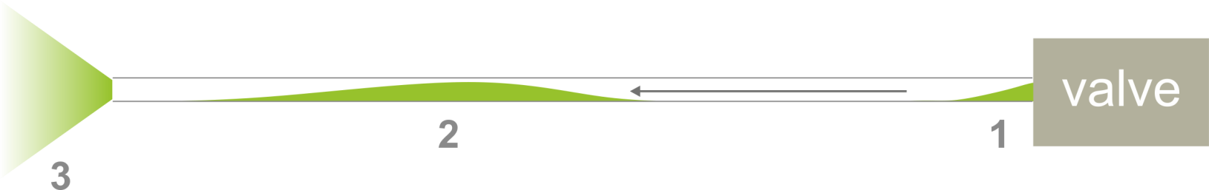
Mitigation of heat loads and electro-magnetic forces
Injection of high-Z impurities
Dissipate thermal and magnetic energy through photonic radiation
Massive Gas Injection (widely explored)

Slide 53

Mitigation of heat loads and electro-magnetic forces
Injection of high-Z impurities
Dissipate thermal and magnetic energy through photonic radiation
Shattered Pellet Injection
(choice for ITER)

Slide 54

Mitigation of heat loads and electro-magnetic forces
Disruption predictor
> 30 ms
Neon injection
Prediction is required to mitigate the thermal quench (< 100%)

Slide 55

Current quench rates after neon injection in ITER
DINA simulations
Neon injection
Plasma current [MA]
time [ms]
1.2
2.4
3.6
4.8
6.0
7.2
8.4
9.6
10.8
12.0
N_{Ne} [10²² atoms]
Eddy current limitation on blankets: N_{Ne} < 5 x 10²² atoms

Slide 56

Current Quench Mitigation
DINA simulations - Neon injection
Halo currents are reduced when the current quench is fast

Slide 57

Current Quench Mitigation
DINA simulations - Neon injection
Magnetic energy is radiated to prevent beryllium melting

Slide 58

Current Quench Mitigation
DINA simulations - Neon injection
Mitigation target
Current mitigation requires about 4x10²¹ neon atoms

Slide 59


Current quench and thermal quench mitigation
DIII-D SPI experiments
Neon injection to control thermal quench radiation and current quench rate
Current quench
Thermal quench
prematurely broken pellets
D. Shiraki et al., Phys. Plasmas 23 (2016) 062516
Thermal quench mitigation has to be within current quench limits

Slide 60
Radiated power during the thermal quench
3D MHD simulation with JOREK for JET:
Radiation during TQ (Ne SPI)
injection location
+ 90 deg
+ 180 deg
D. Hu, EPS 2018
Strong asymmetries in P_{rad} → E_{rad} difficult to measure
→ Power Loads on the first wall can be substantial

Slide 61
The biggest challenge:
avoid runaway electron formation when mitigating heat loads and forces

Slide 62


What is the initial runaway population that can be tolerated?
Maximum initial runaway population (I_{RE} < 0.1 MA)
0D avalanche simulation with conducting vessel
close to S. Putvinski, PPCF 1997:
amplification $\sim exp\left(I_{P}\right)$

Slide 63

What is the initial runaway population that can be tolerated?
Maximum initial runaway population (I_{RE} < 0.1 MA)
*
RE free disruptions
with Be wall in JET

Slide 64

What is the initial runaway population that can be tolerated?
Maximum initial runaway population (I_{RE} < 0.1 MA)
*
RE free disruptions
with Be wall in JET
ITER wall time about 0.5 s plasma current decay induces large vessel currents and avalanche is reduced
*assumption: loss of LCFS @ 10% initial I_{P} (significant margin to DINA results)

Slide 65
What is the initial runaway population that can be tolerated?
Maximum initial runaway population (I_{RE} < 0.1 MA)
*
RE free disruptions
with Be wall in JET
9.5 MA
More runaway seeds can be tolerated with highly conductive vacuum vessel – to be further assessed in theory and experiment
*assumption: loss of LCFS @ 10% initial I_{P} (significant margin to DINA results)

Slide 66
What is the initial runaway population that can be tolerated?
Maximum initial runaway population (I_{RE} < 0.1 MA)
*
RE free disruptions
with Be wall in JET
9.5 MA
10⁵
Runaway avoidance not confirmed for high current operation in ITER
*assumption: loss of LCFS @ 10% initial I_{P} (significant margin to DINA results)

Slide 67
Runaway avoidance by massive deuterium injection
Disruption predictor
> 30 ms
Deuterium + Neon injection
Prediction is required to mitigate the thermal quench (< 100%)

Slide 68

Runaways can be avoided with D₂ in JET
JET runaway domain with Ar/D₂ massive gas injection
Toroidal magnetic field [T]
C. Reux et al., Nucl. Fus. 2015
Argon fraction in deuterium

Slide 69
Runaways can be avoided with D₂ in JET
JET runaway domain with Ar/D₂ massive gas injection
Runaway formation
Toroidal magnetic field [T]
C. Reux et al., Nucl. Fus. 2015
Argon fraction in deuterium
JET mitigated disruptions are RE-free up to 3.25 MA with 90% D₂

Slide 70


Model predictions for ITER
1D simplified model
3D MHD model
JOREK simulation: Density during the SPI triggered thermal quench in JET
N_{atoms}
Current quench time (exp) [ms]
D. Hu, Nucl. Fusion 2018
J.R. Martín-Solís et al., Nucl. Fusion 2017

Slide 71
Second layer of defence:
Dissipate runaway electron energy before it is deposited on first wall components

Slide 72


Dissipating Runaway Energy
Argon injection
$\sim$ 30 ms
Pre-emptive injection for collisional dissipation of runaway energy

Slide 73

Dissipating Runaway Energy
Argon injection
$\sim$ 30 ms
Kinetic simulations
P. Aleynikov, IAEA 2014
Pre-emptive injection for collisional dissipation of runaway energy

Slide 74
Dissipating Runaway Energy
Argon injection
$\sim$ 30 ms
Kinetic simulations
BUT
Experiments show limited assimilation
No indication this will be better for SPI
Modelling predicts scheme ineffective in ITER (runaway scrape-off)
MHD instabilities will prevent ramping down to low enough I_{RE}
P. Aleynikov, IAEA 2014
Pre-emptive injection for collisional dissipation of runaway energy

Slide 75
Can waves help? (Material from C. Paz-Soldan, IAEA FEC 2018)
Alfvénic Instabilities correlate with avoidance
Kinetic instabilities after runaway formation?
Active and passive methods to be studied

Slide 76
Injection Technology

Slide 77

Implementation in ITER
Current quench mitigation
3 upper ports
3 equatorial port
Thermal and current quench mitigation and runaway control

Slide 78


Implementation in ITER
Eddy current
propellant gas
valve
SPI
cold head
Pellet shatter
segment
SPI cryostat
(prismatic)
Pellet guide tube
Double bellows
Microwave cavity
SPI Barrel
Closure plate
Vacuum valve
Vacuum valve
Propellant gas recovery
$\sim$4 m
Long flight tubes require non-gaseous injection

Slide 79



Pellet Shattering Process
Neon + Deuterium
Argon (low speed)
*
~100% shards
20 degree
~50% shards / ~50% gas + liquid
*only 3-8% pellet volume unaccounted
65 degree
Required shard size distribution and gas fraction depends on the purpose: pre-thermal quench, post-thermal quench, runaways
~100% gas + liquid
T. Gebhart, to be published

Slide 80


Pellet sizes and quantities
Pellet speeds:
150-500 m/s
Reaction times:
$\sim$10 - 30 ms (EP)
$\sim$16 - 55 ms (UP)
28 mm
17 mm
20 mm
ELMs/
Fuelling
13 mm
x3 (size tbd)
≤32 (design work ongoing)
 | atoms / pellet |  | Total required*
Ne | 1.2/2.3/3.9x10²³ | > 5x10²² | < 5x10²² | TQ+CQ mitigation
D |  | 1.1x10²⁴ | 3x10²⁴ | RE avoidance
Ar |  | 0.9x10²⁴ | > 10²⁵ | RE energy dissipation
Significant uncertainties in quantities for RE avoidance and energy dissipation
*assimilated quantities

Slide 81
Multiple Injection
Mitigation efficiency linear with N_{injectors}?
Required timing accuracy → Technology development
Size and energy scaling → more tokamaks with N_{injectors} ≥ 2
Reduction of radiation flash heat loads?
First tests with dual injection in DIII-D
N.W. Eidietis, EPS 2018

Slide 82


Ongoing R&D – Tokamak SPI experiments
JET – triple injector in one location (first experiments Nov)
DIII-D – two injectors in two locations
KSTAR – two injectors in two locations (2019)
J-TEXT – planning for two injectors
HL-2A – preparing SPI
KSTAR SPI
Preliminary design by ORNL

Slide 83
Conclusion
Without a reliable and effective
Disruption Mitigation System
and without recipes for operating at
Low Disruption Rates,
ITER cannot achieve its goals
Significant R&D effort is required to close knowledge gaps!
~130 participants at this event, 4 working on related topics (3%)

